Slide 1






ASSIST study: research into support, including social prescribing, for older people with sight loss
Dr Jennifer Acton
Senior Lecturer
School of Optometry and Vision Sciences, Cardiff University

Slide 2
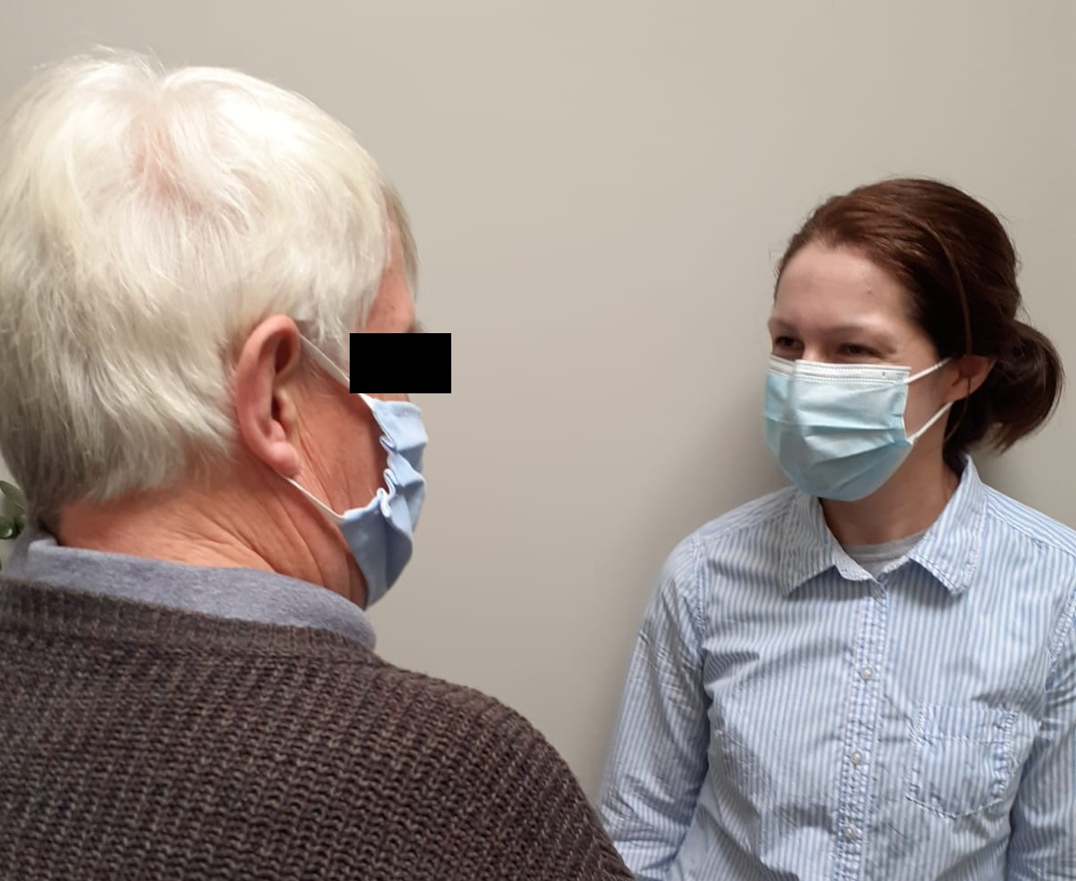
Background
A preventative approach for Access to a Sustainable, whole System pathway for older people with vISion impairmenT (ASSIST)
1.5M people over 65 years in the UK with vision impairment (VI)
Social services, third sector and health care support can help older people maintain independence and social connections, when VI requires major lifestyle adjustments
Welsh policy comprehensive: Social Service & Wellbeing Act (Wales) 2014 Code of Practice requires ‘sensory impairment rehabilitation’
But access and navigation of the support can sometimes be a problem
Social prescribing “connecting people to community support to better manage their health and wellbeing”

Slide 3

A preventative approach for Access to a Sustainable, whole System pathway for older people with vISion impairmenT (ASSIST)
Aim:
To look at the current provision of care and support for older people with VI in Wales. Identification of gaps, discontinuity in access and areas of best practice will allow improvement and sustainable ‘joined up’ solutions to be identified, with a focus on strengthening preventative approaches.

Slide 4
ASSIST: Research questions
For whom does the current provision of support for older people with VI work, how, why, to what extent, and in what context?
Are the needs and interests of citizens with VI being met by existing services?
What and where are examples of good practice at the holistic, medium, and light levels of social prescribing (Wallace et al. 2021) as well as gaps in provision or access?
How can access to and navigation of services be improved for citizens with VI?
How could community/primary care-based professionals who have contact with people with VI facilitate more seamless access to services?
What is the economic impact of enabling easy access to care and support?

Slide 5
Workstream 1: Literature reviews
Realist Cycle One
Rapid Realist Review
Health economic literature review
Realist Cycle Two
Survey (n=297)
Semi-structured interviews with people with VI
Workstream 3: Health Economic model development
Workstream 2: Qualitative exploration with stakeholders
Realist Cycle Three
Focus groups /Semi-structured interviews with staff who support people with VI
Health economic modelling
Workstream 4: Integration of findings and dissemination
Triangulation

Slide 6
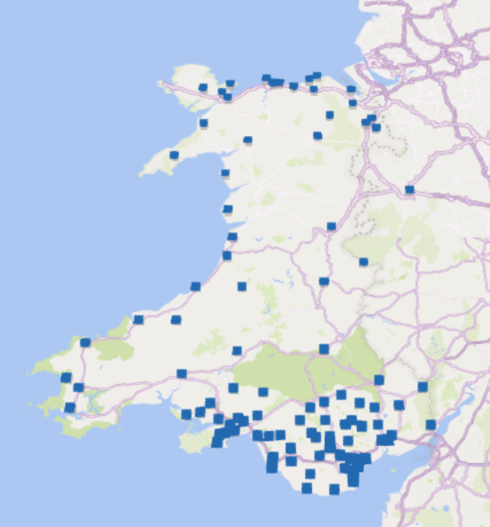
Preliminary results: survey

Slide 7
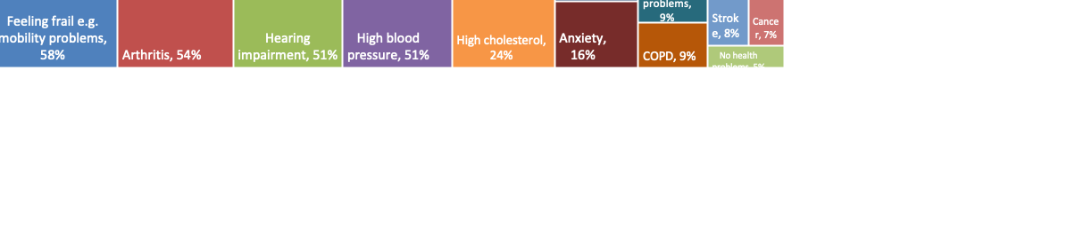
Preliminary results: survey
Notes:
Data labels

Slide 8

Preliminary results: survey
Registration
 | Responses (n) | Yes | No | Can't remember
Was the registration process explained to you at any stage? | 142 | 46% | 23% | 30%
Did you feel the person you spoke to about the registration process understood your sight loss? | 133 | 52% | 15% | 33%
Were you informed about your rights and entitlements? | 140 | 38% | 28% | 34%
Immediately after your eye condition diagnosis, did you speak to anyone who was able to offer support, advice or information? (e.g. ECLO) | 278 | 37% | 44% | 19%

Slide 9
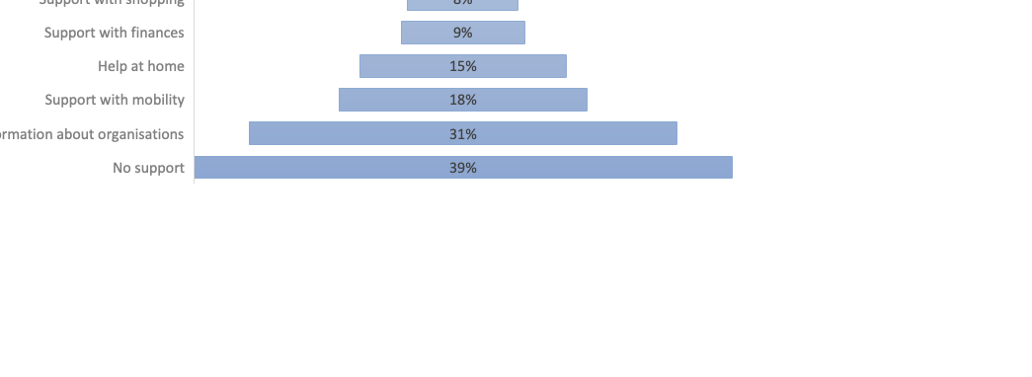
Preliminary results: survey
Assessment
 | Responses (n) | Yes | No | Can't remember
Did you receive an assessment of your needs or a “what matters conversation” from your local council or sensory support team, or vision rehabilitation officer? | 282 | 36% | 50% | 14%
Did you feel the person who carried out your assessment understood vision impairment and its challenges? | 135 | 77% | 10% | 13%

Slide 10
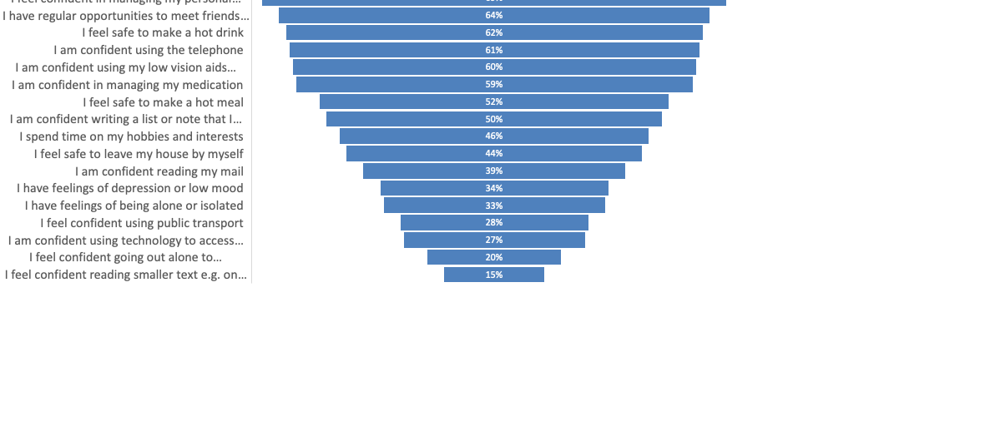
Preliminary results: survey
n=291
% agreed

Slide 11
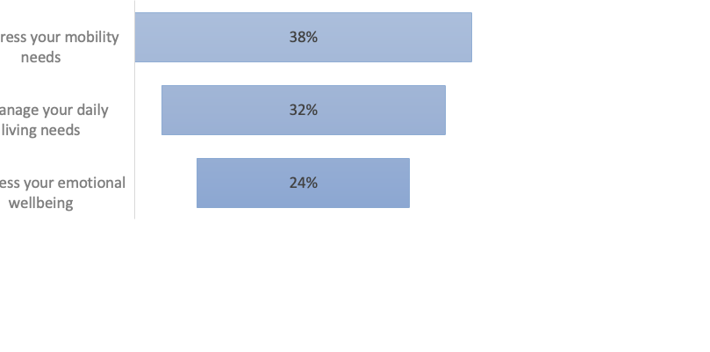
Preliminary results: survey
% who answered yes

Slide 12
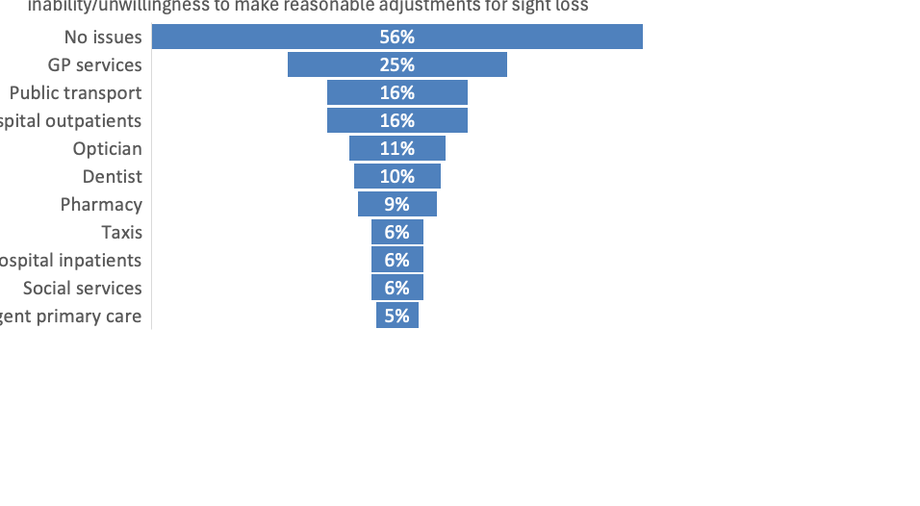
Preliminary results: survey

Slide 13
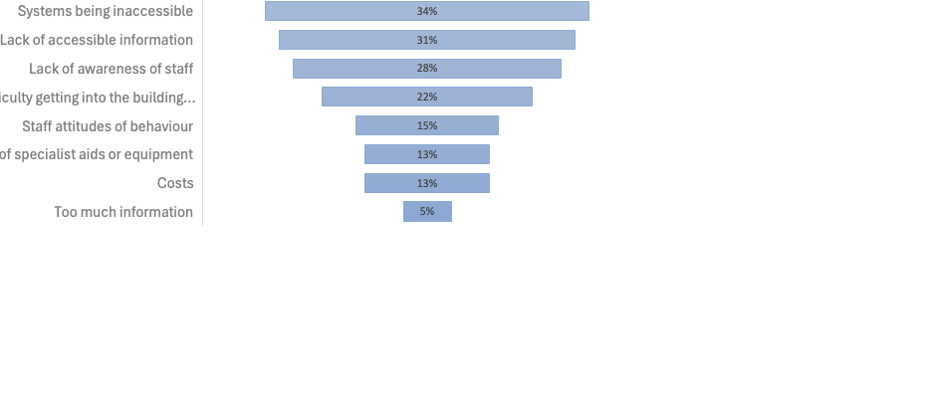
Preliminary results: survey
Thinking of a time when you faced the biggest challenge with accessing services because of your sight loss, was it because of....

Slide 14

Addressing systemic inequalities
Access to services
Enablers
Inhibitors
Relationships
with Community Assets
with Professionals
Developing a knowledge of the eye condition
Positive Care Trajectory
with carers & family
Readiness /acceptance for help
Older person with VI
Timeliness

Slide 15

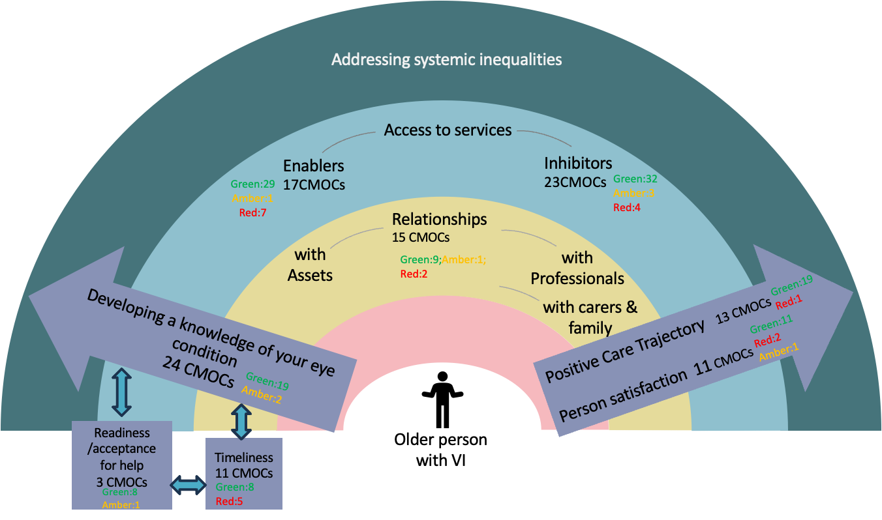
Ongoing work….
Analysis of qualitative interviews with older people with vision impairment and focus groups with staff who support this population
Health economic modelling
Integration of work streams
Integration of the data collected across work streams will be used to refine the draft programme theory

Slide 16



Acknowledgements
Ophthalmic Public Health Group, School of Optometry and Vision Sciences, Cardiff University
Dr Jennifer Acton
Prof Barbara Ryan
Prof Rachel North
Dr Anju Vaidya
Dr Pippa Anderson
University of South Wales
Prof Carolyn Wallace
Dr Mark Davies
Lisa Griffiths
Swansea University
Dr Mari Jones
Dr Esra Erdem
Brunel University
Prof Fiona Verity
Project Advisory Group
Dr Bablin Molik, Sight Cymru
Richard Bowers, Wales Council for the Blind
Ian Moran, Chair of The Welsh Rehabilitation Officers Forum
Rebecca Colclough, RNIB
Richard Harvey, Sight Life
Lowri Bartrum, Vision Support
John Dixon, RNIB
Gareth Williams, Optometrist
Alan Evans, Optometrist
Russell Ham, Optometrist
Dr Yannis Pappas, University of Bedfordshire
Prof Mary Lynch, Royal College of Surgeons in Ireland
Susan Hughes, lay member
Hilary Lester, lay member
Tubassum Munawar, lay member
Dr Sarah Wallace, USW
Recruitment support
Rebecca John, GOSW Clinical Lead
Mrs Rhianon Reynolds, ABUHB, Cardiff University
Dr Angharad Hobby
Dr Nik Sheen
Mrs Sharon Beatty

