Slide 1







Centre for Vision Services Research

Slide 2
Vision services
Diabetic screening
School Screening
Optometry practices
Hospital Eye Service
Rehabilitation
Social Care
Voluntary organisations
Social prescribing

Slide 3
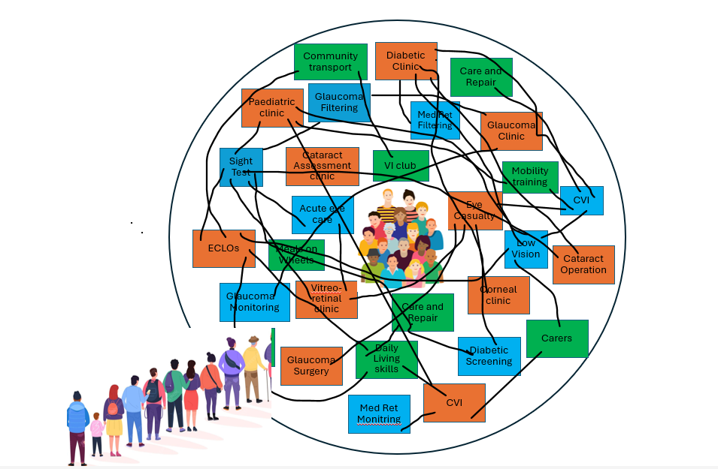
Vision Services
=
A complex health and social care
ecosystem for people with sight problems

Slide 4
Centre for Vision Services Research
The Centre for Vision Services Research employs robust research methods to inform and optimise services for individuals with sight problems.

Slide 5
What elements of vision service do we most need to make better?
What ideas are there to make vision services better?
When we try those ideas do they make things better? How?
Reduce the waiting times
Make services easier to access
Enable more people to benefit from the service
Enable more people to read, cook for themselves or garden
Reduce the cost
Enable them to be available to everyone in all parts of the country
Ensure people are better informed

Slide 6
































Sight Test
Community transport
Diabetic Clinic
Care and Repair
Paediatric clinic
Glaucoma
Filtering
Med Ret Filtering
Glaucoma Clinic
Cataract Assessment clinic
VI club
Mobility training
Acute eye care
Eye Casualty
CVI
ECLOs
Low Vision
Meals on Wheels
Cataract Operation
Glaucoma
Monitoring
Vitreo-retinal clinic
Corneal clinic
Care and Repair
Meals on Wheels
Carers
Daily Living skills
Diabetic Screening
Glaucoma Surgery
CVI
Med Ret Monitring

Slide 7

Dr Jennifer Acton (Optometrist) Patient Related Outcome and Experience Measures in Eye Care Patient Safety in Eye Care Quality of life and vision in Care Homes Dr Ashleigh Kernohan (Nov 2025) (Optometrist + Health Economist) Evaluating the costs and benefits of different interventions with a special interest in eye care Dr Claire Nollet (Psychologist) Trial management Psychological interventions Mental Health and Well Being people with sight loss

Slide 8

Dr Becky Thomas (Diabetic screening) Intervals of care Data analysis Impact of non-ophthalmologists doing laser treatment Images from eye care into general healthcare database Dr Dianne Seddon (Social Care) Carers who have sight loss

Slide 9
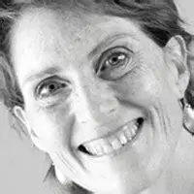
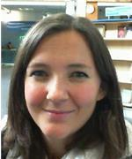

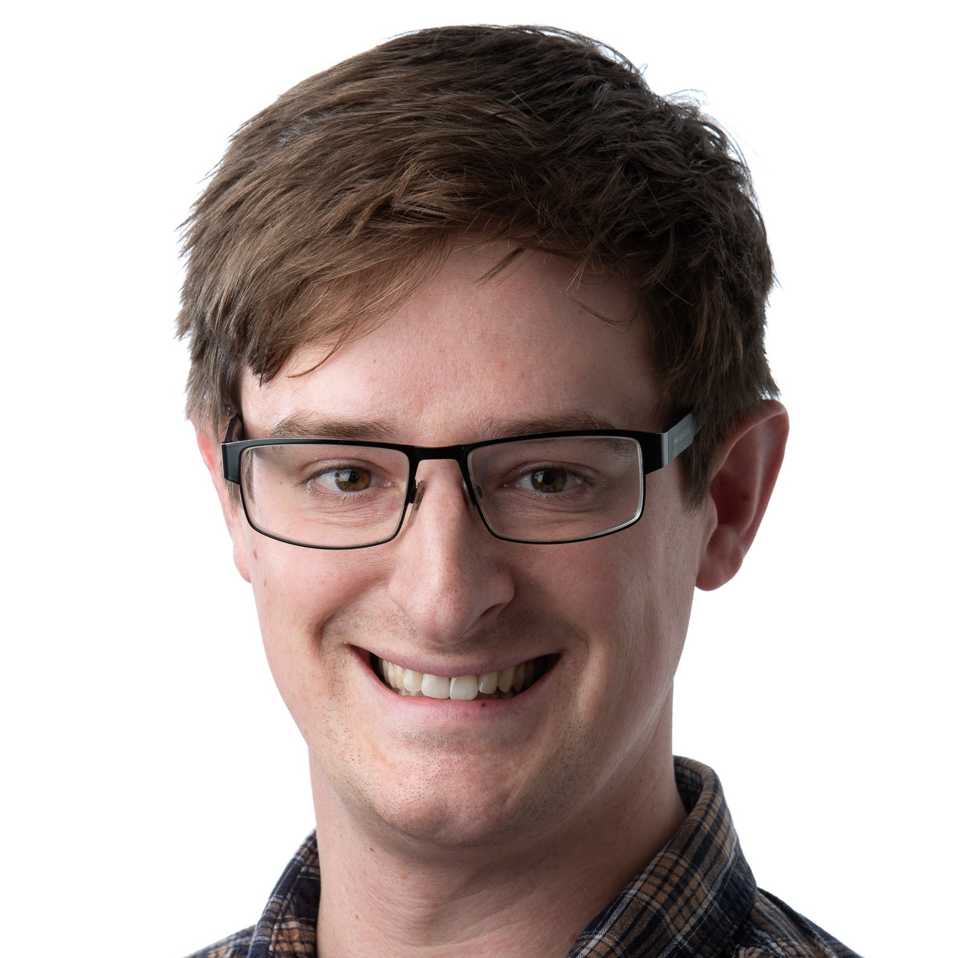

Methodology Experts
Dr Pippa Anderson Health Economist Dr Mari Jones Health Care Modeller Dr Tim Pickles Statistician and PROMS

Slide 10

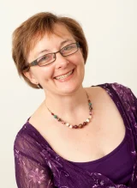
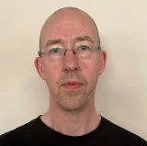

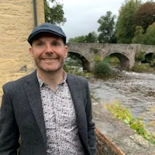
Methodology Experts
Prof Carolyn Wallace Qualitative methodologies Dr Mark Davies Qualitative methodologies Dr Prof Paul Willis Adult Social Care

Slide 11


Health Care Professionals
Patient and Public involvement and engagement
Emma Richards (Co-Ordinator )
Rhianon Reynolds
Colm McAlinden
Wai Siene Ng
Barbara Ryan
Rachel North

Slide 12

Developing a research culture and team Collaboration and Relationships
Tell us what the priorities should be
Help us recruit people to take part in research
Become involved in research
Become a researcher yourself- Msc, PhD, Fellowship
Link with us

Slide 13
Centreforvisionservicesresearch@cardiff.ac.uk

