Slide 1

Hospital to Community: identifying the value of optometrists monitoring & managing chronic sight threatening eye disease in primary care.

Slide 2







Slide 3
Background
People diagnosed with wet AMD and glaucoma require life-long ophthalmic support, monitoring, and treatment to avoid irreversible sight loss
Management of chronic eye diseases typically takes place in hospital eye services (HES) which are heavily oversubscribed
So what happens if optometrists in their practices help out?
Notes:
People diagnosed with chronic sight threatening eye diseases such as glaucoma and age-related macular degeneration (AMD) require life-long ophthalmic support, monitoring, and treatment to prolong their sight and avoid irreversible sight loss¹
This fact is huge on the prevention and well-being agenda

Slide 4
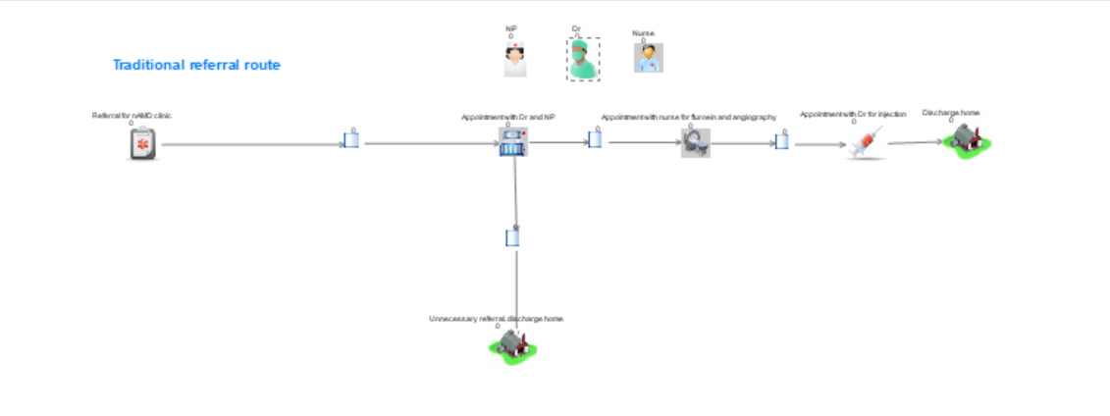
Health Economic modelling
Health economic modelling allows us to try things out based on what we have learned from the services.
Maps people’s time and the costs
Notes:
Describe what happens in RAC

Slide 5
Wet AMD Results – in 1 year
Outcome | Traditional Wet AMD | With Consultant Virtual Review | Wet AMD Optometry Decision
Costs to run service for 1 year | £217,147 | £185,820 | £184,289
Number Optom visits | 0 | 1461 | 1461
Number of HES visits | 964 | 285 | 411
Number ophthalmology virtual reviews | 0 | 1445 | 0
Average waiting time for secondary care appt | 585 days | 6 days | 10 days
Number left on waiting list | 2318 | 6 | 20
% of time consultant is “busy” | 77% | 21% | 20%

Slide 6
Wet AMD Results – in 1 year
Outcome | Traditional Wet AMD | With Consultant Virtual Review | Wet AMD Optometry Decision
Costs to run service for 1 year | £217,147 | £185,820 | £184,289
Number Optom visits | 0 | 1461 | 1461
Number of HES visits | 964 | 285 | 411
Number ophthalmology virtual reviews | 0 | 1445 | 0
Average waiting time for secondary care appt | 585 days | 6 days | 10 days
Number left on waiting list | 2318 | 6 | 20
% of time consultant is “busy” | 77% | 21% | 20%

Slide 7
Wet AMD Results – in 1 year
Outcome | Traditional Wet AMD | With Consultant Virtual Review | Wet AMD Optometry Decision
Costs to run service for 1 year | £217,147 | £185,820 | £184,289
Number Optom visits | 0 | 1461 | 1461
Number of HES visits | 964 | 285 | 411
Number ophthalmology virtual reviews | 0 | 1445 | 0
Average waiting time for secondary care appt | 585 days | 6 days | 10 days
Number left on waiting list | 2318 | 6 | 20
% of time consultant is “busy” | 77% | 21% | 20%

Slide 8
Wet AMD Results – in 1 year
Outcome | Traditional Wet AMD | With Consultant Virtual Review | Wet AMD Optometry Decision
Costs to run service for 1 year | £217,147 | £185,820 | £184,289
Number Optom visits | 0 | 1461 | 1461
Number of HES visits | 964 | 285 | 411
Number ophthalmology virtual reviews | 0 | 1445 | 0
Average waiting time for secondary care appt | 585 days | 6 days | 10 days
Number left on waiting list | 2318 | 6 | 20
% of time consultant is “busy” | 77% | 21% | 20%

Slide 9
Glaucoma Monitoring Results – in 1 year
Service Model Outcome | Traditional Glaucoma | Consultant Virtual Review | Primary Care Decision | Hospital Optometrist Virtual Review
Cost to run the service for 1 year | £311,824 | £365,860 | £300,819 | £332,317
Number of optom appointments | 0 | 3138 | 3138 | 3138
Number of HES appointments | 2008 | 431 | 626 | 433
Number of ophthalmology virtual reviews | 0 | 3138 | 0 | 3138 (with optometrist)
Average wait time | 642 days | 3 days | 3 days | 5 days
Number on the waiting list | 6418 | 5 | 5 | 5
% time consultant is ‘busy’ | 54 | 22 | 21 | 21

Slide 10
Patient-reported experience measure (PREM)
Patients in hospital and Optometry Practices
802 patents, 2/3 from the primary care pathways and 1/3 from hospitals
62% from glaucoma services
Patients were happy with the experience they had in both optometry practices and hospitals.

Slide 11
Qualitative work
57 participants in 4 focus groups and 41 semi- structured interviews each lasting 40-60 minutes:
Patients (conducted first)
Carers
Receptionists
Practice managers
Health Board managers, Optometrists
Ophthalmologists
Optical care assistants
Nurse practitioners
Healthcare support workers
Dispensing opticians
Orthoptists
Imaging personnel

Slide 12
Patients found optometry practices more accessible
Geographically (less travel)
Liked the flexibility in arranging appointments.
Hospitals were physically more inaccessible

Slide 13
Referral Co-ordinators are important
Integration between hospitals and optometry practices requires coordination.
A referral coordinator ensures the number of patients matches the capacity to meet demand.
If this role is missing, the capacity is reduced and inefficient use of primary care clinics.

Slide 14
Effective communication between optometrists and ophthalmologists is important
We found that effective communication between primary and secondary care facilitates supporting collaborative service integration.
Building this trust and confidence in the abilities of primary care services emerges from effective communication and feedback loops.
Shared electronic records helps.

Slide 15
Patient information is essential
If patients receive clear information that optometry practices are providing hospital appointments, patients trust primary care practitioners.
Important patients understand the road map of their care.
Patient information about their conditions is important- delays lead to lack of confidence.

Slide 16
"Not very confident....and to be perfectly frank when the results come back after I’ve had my last of the examination....I might have had the examination in April and generally I get the letter in October because it takes 3 or 4 months for it to be typed...absolutely hopeless."

Slide 17
What does this mean?
The optometry services cost slightly less, similar or are slightly more expensive
But all models save consultant appointments
All models involving optometry services substantially reduce waiting times.
This is important- because delays in these services can lead to people losing sight.
Patients like the services in optometry practices
Key to success is timely patient information and a co-ordinator

Slide 18
Prof Barbara Ryan, Optometrist in Aneurin Bevan UHB
Prof Rachel North, Cardiff University School of Optometry
Prof Carolyn Wallace, University of South Wales
Dr Mark Davies, University of South Wales
Lisa Griffiths University of South Wales
Rebecca Nicholls, University of South Wales
Dr Pippa Anderson, Swansea University
Dr Mari Jones, Swansea University.
Dr Bablin Molik, Chief Executive, Sight Cymru
Ms Rhianon Reynolds, Aneurin Bevan UHB
Mr Ahmed Kasb, Aneurin Bevan UHB
Sali Davies, Chief Executive, Optometry Wales

Slide 19
Stakeholder Group
Patients
Third sector organisations
Optometrists
Ophthalmologists
Nurses
Managers

