Slide 1



Talking about Low Vision & Mental Health: Patient Perspectives
Dr Claire Nollett
Cardiff University

Slide 2


Background
Notes:
Jen comment: what is MDD?

Slide 3
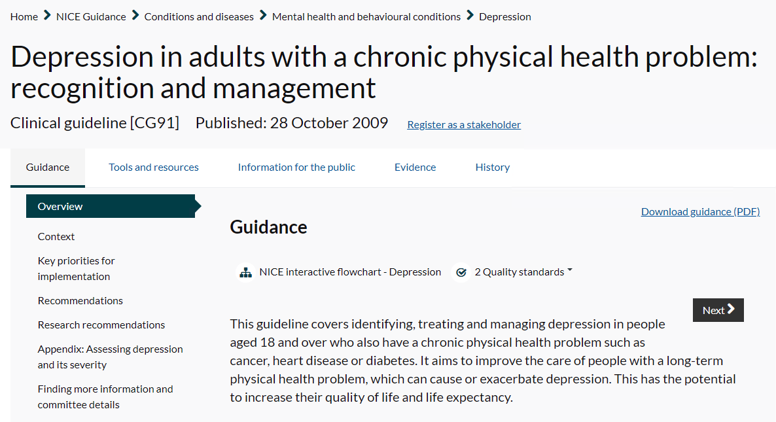
Identification

Slide 4
Identification
Be alert to possible depression (particularly in patients with a past history of depression or a chronic physical health problem with associated functional impairment) and consider asking patients who may have depression 2 questions, specifically:
During the last month, have you often been bothered by feeling down, depressed or hopeless?
During the last month, have you often been bothered by having little interest or pleasure in doing things?

Slide 5

LVSW Assessments

Slide 6
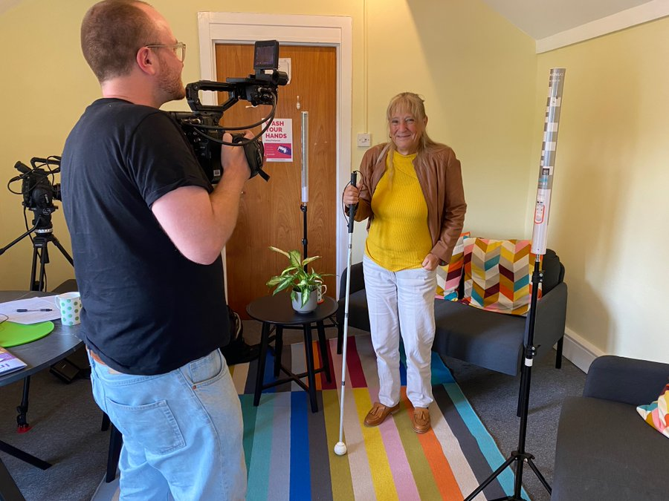
Teaching Students

