Slide 1
Dr. Fiona Jenkins MBE Executive Director Therapies and Health Science Cardiff and Vale UHB
Eye Care Services,
The National Context
22/11/23

Slide 2
The items I’ll cover
The national programme for eye care
Key deliverables
Get it right first time
Digital patient record

Slide 3
The NHS Executive (Strategic Programme for Planned Care) and Welsh Government eye care priorities:
Demand, capacity, activity, and backlog positions
Workforce and training in Ophthalmology
Infrastructure ( including the deployment of a digital patient record) and
Care Pathways to ensure services become more sustainable
Reduction of long waiting times
The first report and recommendations will be provided back to Welsh Government in early 2024, with follow up reports and further work at a sub-specialty level to follow.

Slide 4
The National Ophthalmology Clinical Implementation Network (CIN)
Focus on the shorter to medium term improvements and the Getting It Right First Time (GIRFT) reviews of Glaucoma and Cataract. Rhiannon Reynolds new Llewydd ( lead Dr).
Their key programme priorities and deliverables are:

Slide 6
Get it right first time
GiRFT were commissioned to undertake the reviews of all Health Boards and have visited each hospital site. Health Board action plans following the reviews are being completed and the actions will be progressed in monthly meetings with GiRFT and NHS Executive colleagues over a six-month period, from September 2023.

Slide 7
GiRFT Project Priorities
Provide an overall picture of the specialty and identify outliers.
Focus on system and Health Board level to take out unwarranted variation in access to care and the outcomes of care.
Drive for ‘top decile’ GIRFT performance of outcomes, productivity and equity of access.
Standardise procedure-level clinical pathways in line with the GIRFT pathways which are developed by ‘expert advisory panels’ and supported by professional societies.
Review the potential of establishing networks and how this might be done.
Agree principles for working across clinical and operational groups e.g., theatre principles.
Leave a legacy of sustainable quality improvement by working in partnership with your clinical, operational, and analytical teams.

Slide 8
Health Board Recovery Plans
Short term outsourcing / insourcing options
Regional plans including ‘hub and spoke’ models of care.
High volume, low complexity centres focussed on reducing the cataract backlog.
Plans to refine the cataract pathway
Monthly Eye Care performance meetings with Health Boards, some working at a regional level have been established by Welsh Government

Slide 9
The Eye Care Digital Programme
The introduction of Open Eyes started pre COVID, but roll out got delayed
Deployed in Cardiff and Vale and CTM UHB
Programme has moved over to DHCW to lead and deploy on a national basis
Programme has been “paused” for 6 months, but should hopefully progress soon.

Slide 10



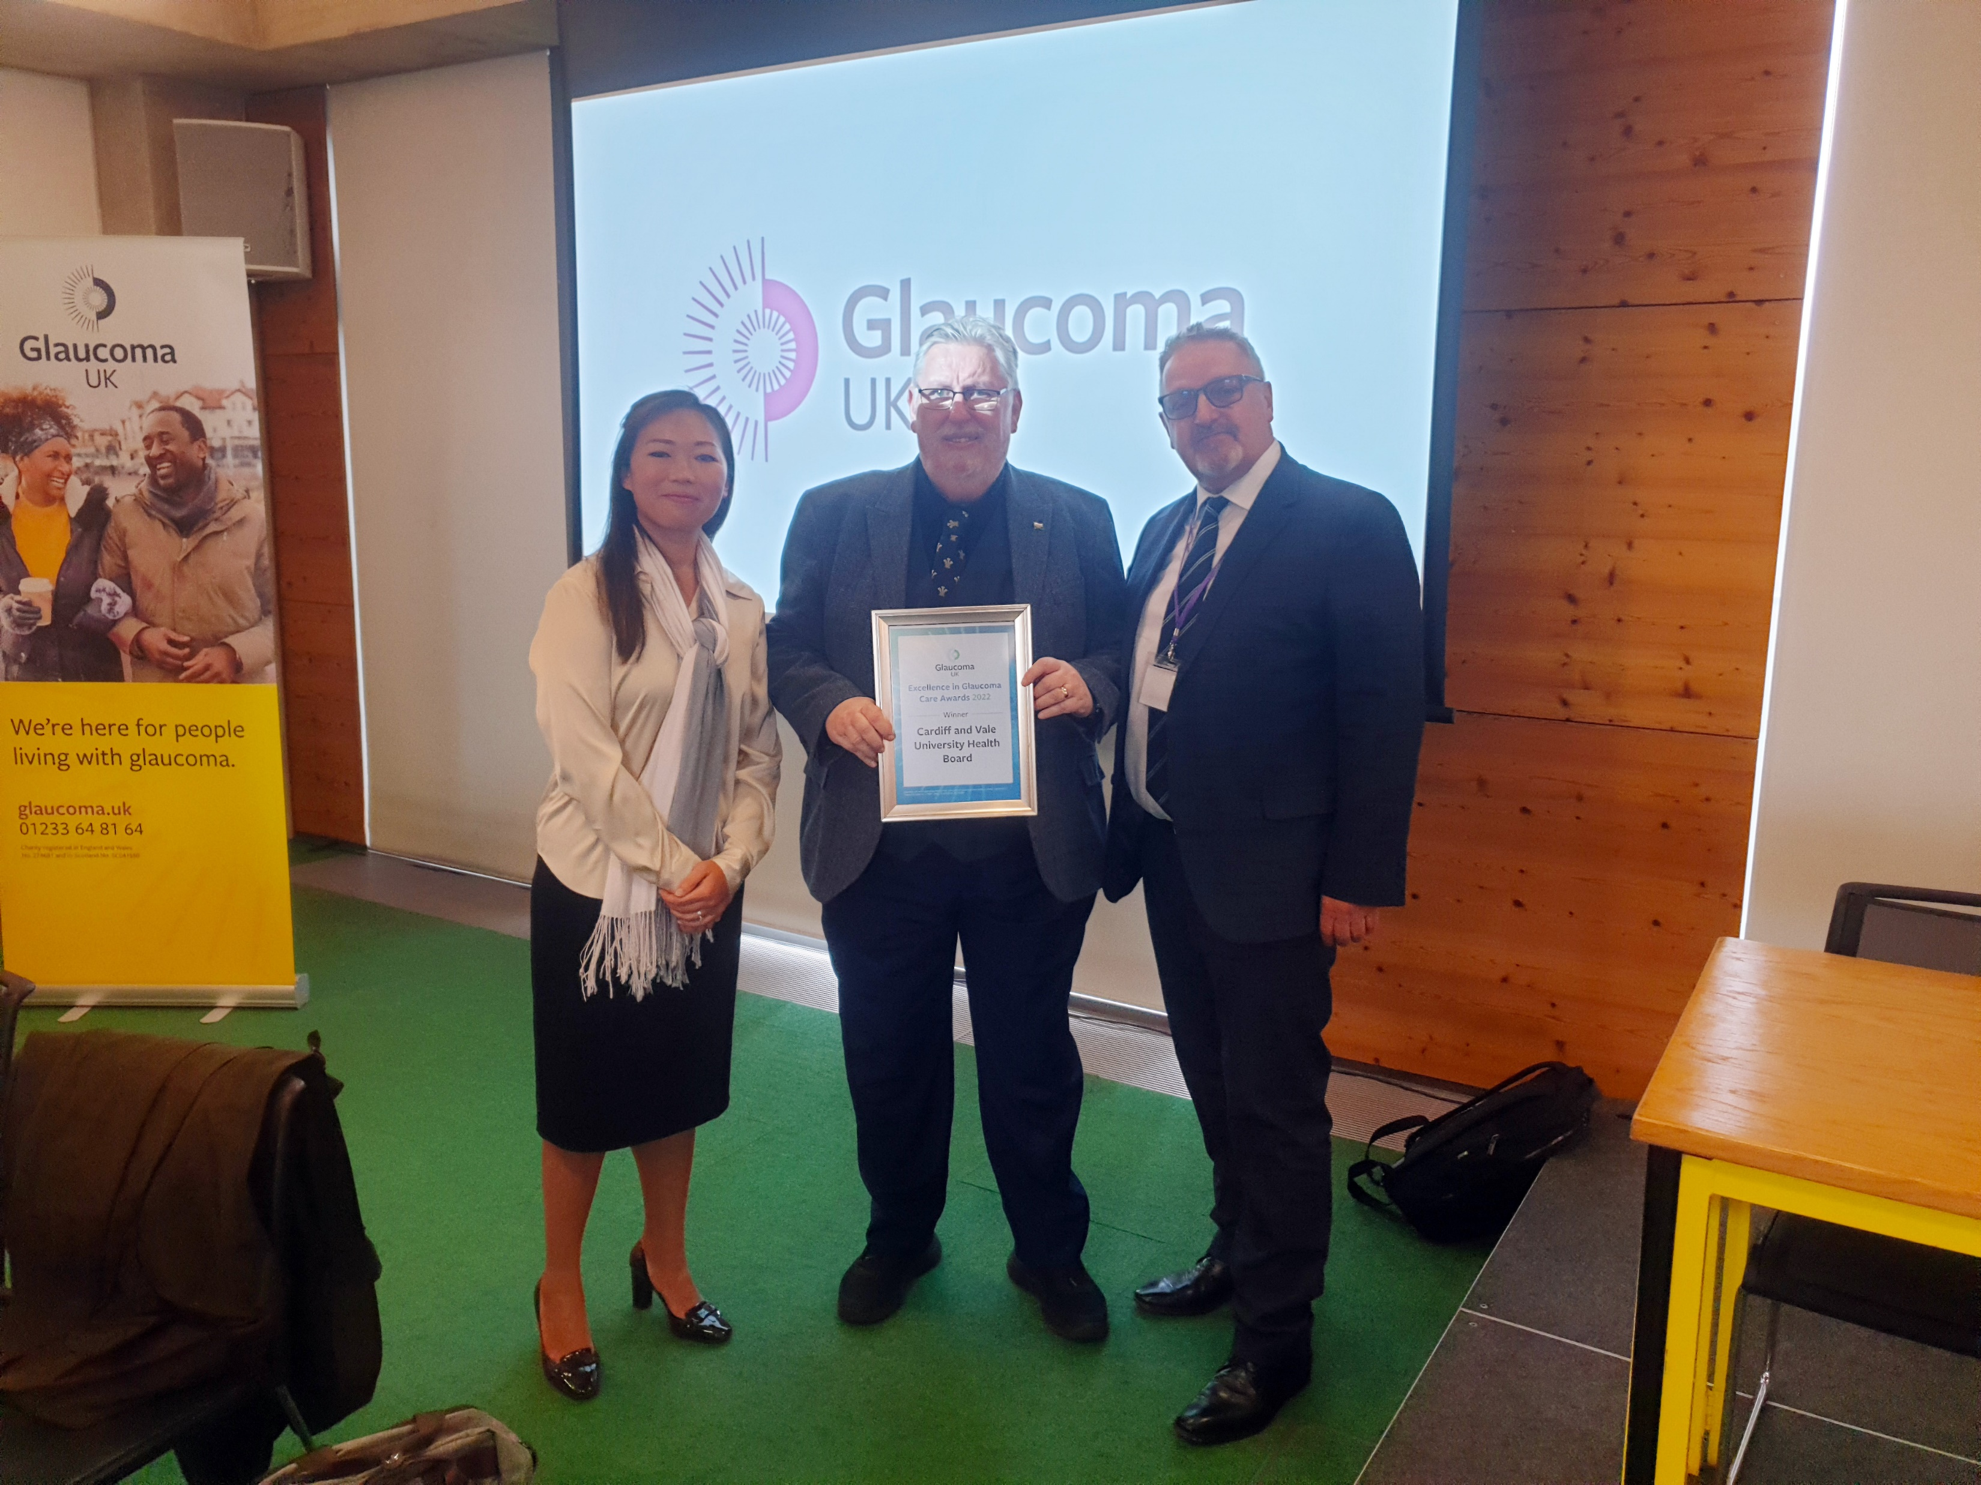

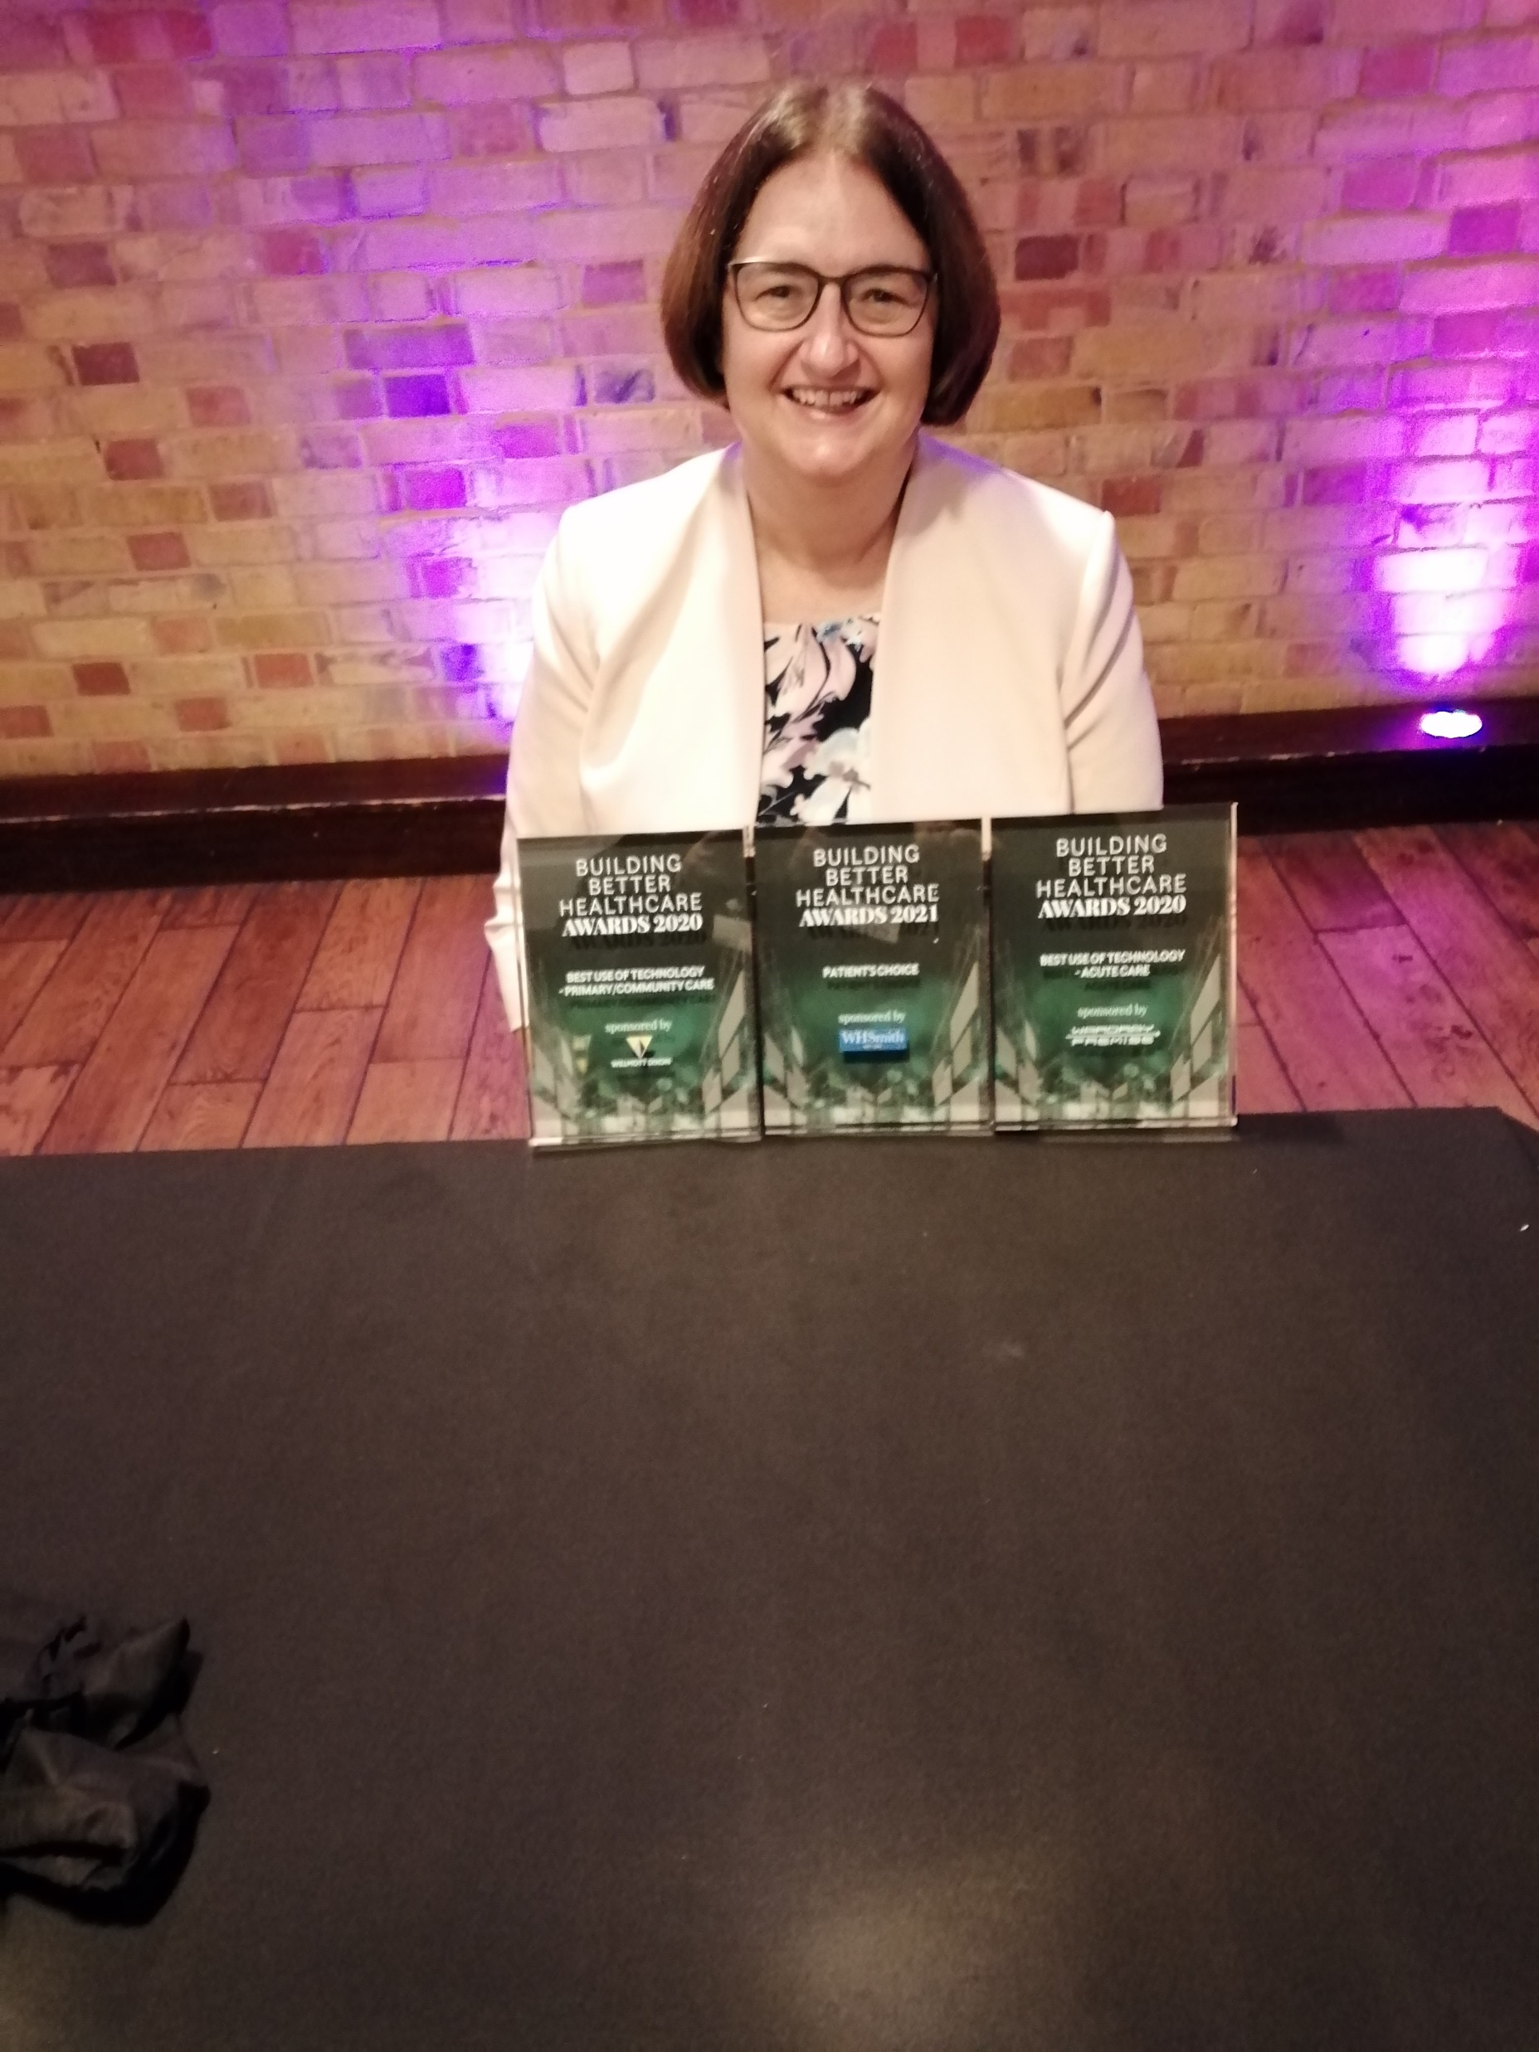


The “shared care” programme implemented in Cardiff and Vale UHB
Notes:
Opticians Award 2021 Highly Commended and again Finalist at The Hilton Park Lane London 30th November 2022
Gareth Bulpin and Wai Siene Ng Winners of the Glaucoma Patients Choice award 2021 in London
Gareth Bulpin and Wai Siene Ng Winners of the MediWales Judges Award for Innovative Healthcare 2021
The Team at the Health Service Journal Awards 3 times finalist Highly Commended and Commended in London 2021
Sharon Beatty Winners of the Building Better Healthcare Best use of Technology – Acute Care and Best use of Technology – Primary/Community Care 2020 and Patients Choice 2021
The Team
Health Personnel Management Awards 2021 Highly Commended again Finalist in Birmingham 1st December 2022
Leading Healthcare Awards 2022 Highly Commended
Health Technology Network Awards 2021 Highly Commended

Slide 11

The Top Award Health Service Journal Digital!

Slide 12
And to conclude
There is much improvement needed, the Covid pandemic sent us backwards
Primary care reform for eye care is an exciting addition
We need to embrace digital records and referral mechanisms, these systems will connect the whole pathway, and will transform care
We MUST keep our attention on what this means for service users

