Slide 1

See Cymru Differently

Slide 2
What is See Cymru Differently?
See Cymru Differently is a 3 Year National Lottery funded project designed to address 2 key areas:
1. Promote the importance of Eye Health & Eye Safety within the Welsh Agricultural community.
2. Make the Welsh National Parks and National Landscapes Accessible for people with Low or No Vision.

Slide 3
What are Guide Walkers?
A partnership with Mountain Training to evolve the Guide Runner model.
Qualified and experience Mountain & Low Land Leaders.
Undertake a 2-day training course designed by the See Cymru Differently Team & Mountain Training.
Training – Sight Loss Awareness, Risk Assessment, Outdoor Guiding and Verbal Description Techniques.
Participants apply the training out on the hills with Low or No Vision walkers.
Adapted outdoor kit.
Making the Welsh/UK Landscapes truly accessible for all & meeting the projects Strategic aims.

Slide 4
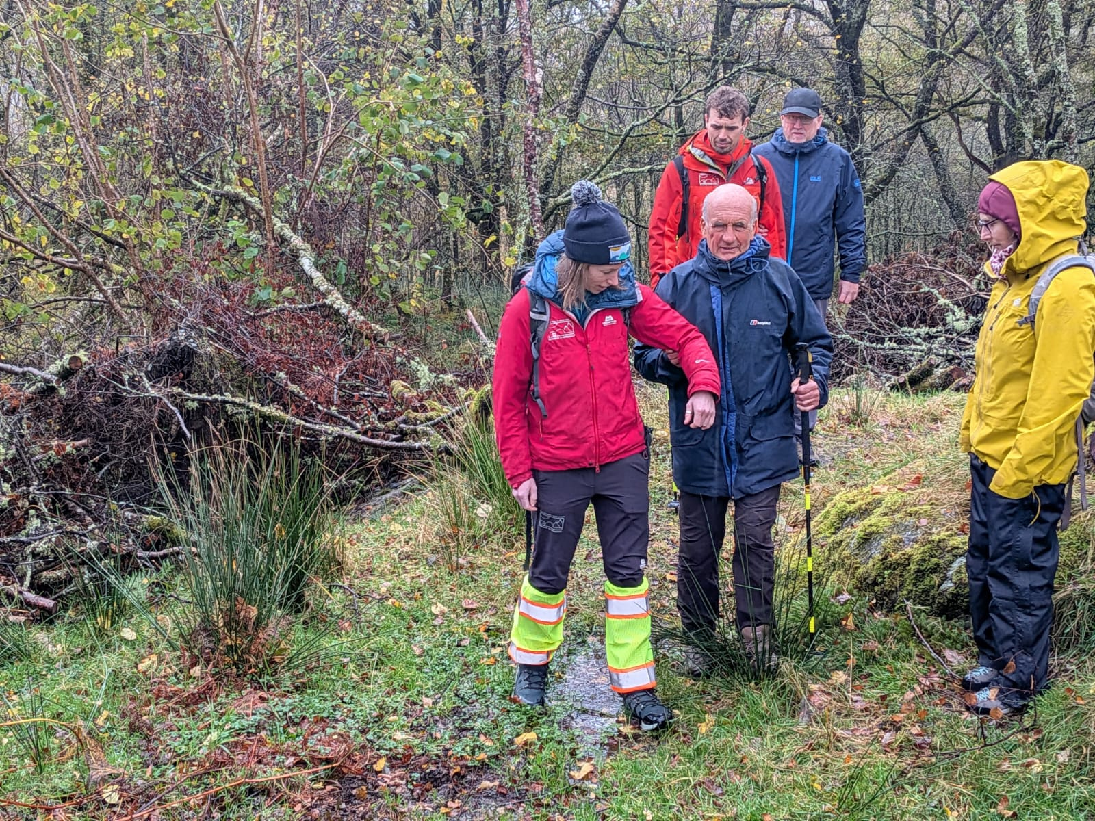
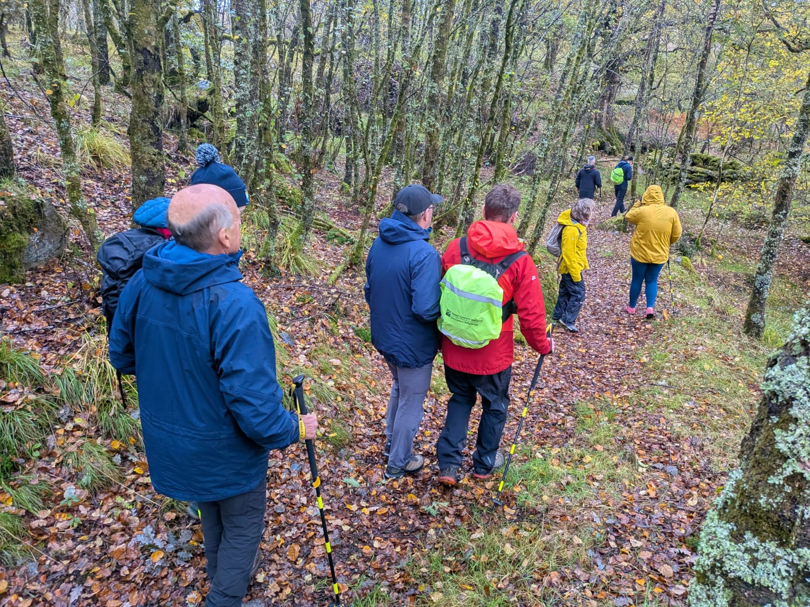
Guide Walking In Action: Plas-Y-Brenin, Eryri

