Slide 1
Eye care support pathway: access to non-clinical support

Slide 2
Patient experience of pain points
“I was diagnosed with Retinitis Pigmentosa and told that there was nothing that could be done. I should wait to go blind, and it could happen in a matter of years, months or even weeks. This utterly shattering diagnosis haunted me for years. I was never sign-posted to any services, so never knew anything about an ECLO, rehab, local peer support, technology aids, mobility aids, education support, nothing.
“I hated my life and went into a quiet state of depression. It took 15 years to finally get sign-posting to vital support, to meet others with my eye condition and others living with a vision impairment. Now in the past decade of learning all about the stages in the pathway, I know about the right kind of support which should be available, and it has enabled me to build my life back up from feeling quite low.”

Slide 3


Slide 4
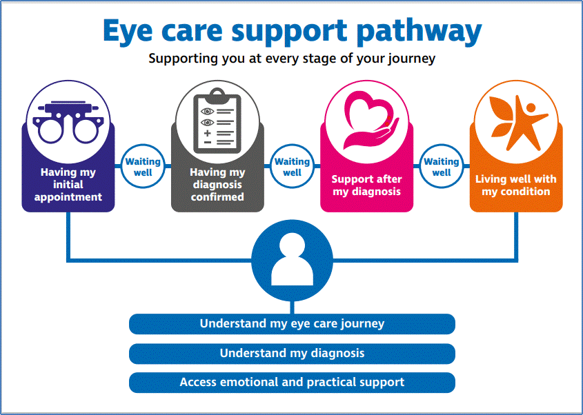

Slide 5
Next steps
Agreement with Wales Council of the Blind to develop implementation plans for Wales
Wider partnership to develop – volunteers?
Offer to Welsh Government as sight-loss sector contribution to the development of 3Ps policy
Patient support adopted within revised pathways and new strategies for NHS Wales

