Slide 1
Effective Communication & Breaking Bad News
WCB Wales Eyecare Conference
22.11.23

Slide 2
Communication & Breaking Bad News
Broken down into 2 different stages
Why is communication important to me?
3 different models of Breaking Bad News (BBN)

Slide 3
Introduction
Introduction
What is Bad News?
‘Bad news by any diagnosis that negatively alters the patients view of his or her future.’
Oncologist Robert Buckman co-founder of SPIKES method
Bad News is always ‘in the eye of the beholder’
For example a patient who is told their blurry vision is from Wet AMD rather than just needing a stronger pair of glasses.

Slide 4
Famous sayings about communication
‘The patient will never care how much you know, until they know how much you care’
Teddy Canale on his American Academy of Orthopaedic Surgeons Vice Presidential address
‘People will forget what you said, people will forget what you did. But people will never forget how you made them feel’.
Maya Angelou, American Poet & Civil Rights Activist

Slide 5
Breaking Bad News models
Breaking Bad News Models
SPIKES developed by Oncologists Robert Buckman & Walter Bailie in 2000. This the Model used in GP training by Royal College of General Practitioners and other HCPs
ABCDE
BREAKS

Slide 6
S P I K E S
SPIKES
S Setting Do you have enough time, is this the right place? Mental rehearsal, how will respond to negative emotions
P Perception How much does your patient know and understand
I Invitation for Information
K Knowledge, Is the information sufficient and clear
E Empathy What is the impact of what you say and how you say it
S Summary/Strategy: do you check for understanding

Slide 7

Setting?

Slide 8
Setting
Setting
Involve significant others, family members especially for cognitive issues- ‘Do you have anybody with you today’ or ‘Two memories are always better than One’
Sit Down/Stand Up mirror other persons position, be at eye level when communicating
Look Attentive and calm – Eye Contact
Listening Mode: Active Listening vs Passive Listening

Slide 9

Bringing in another family member

Slide 10
Perception
Perception
‘What did you think yourself?’
‘What have you been told so far?’
‘Do you know the reason why I brought you back today?’
Are you worried that this might be something serious?

Slide 11
Invitation
Invitation
Are you the type of person who wants to know all the details or just the major ones?
How much information would you like me to give you about the diagnosis and its treatment?
Would you like some patient information leaflets?
Would you like me to recommend some good websites to look at?

Slide 12
Retained Information
Numerous studies have been made talking about the amount of medical information that is recollected by a patient.
Greater the amount of information = the lower the proportion is recalled.

Slide 13
Patient’s Memory for Medical Info , 2003, R P C Kessels, JRSM
Amount of Medical Information that is forgotten?
Amount of info that is remembered that is incorrect?
Percentage of Spoken Info remembered correctly?
Percentage of written/Pictorial info remembered corectly?

Slide 14
Patient’s Memory for Medical Info , 2003, R P C Kessels, JRSM
Amount of Medical Information that is forgotten? 40-80%
Amount of info that is remembered that is incorrect? 50%
Percent of Spoken Info remembered correctly? 10%
Percent of Written/Pictor info remembered correctly? 80%

Slide 15
Patient Engagement Strategies
Patient Engagement= Act of patient & provider working together toward an end gal of improved patient wellness.
Verbal Dominance= provider speaks more than the patient= a lower patient recall rate
Patient Teach Back- Explain medical information, treatment options, or self-care instructions to patients. Then you ask patients to repeat the info in their own words.
Low Cost, Low Technology Intervention

Slide 16

Patient Information Leaflets (PILs)

Slide 17
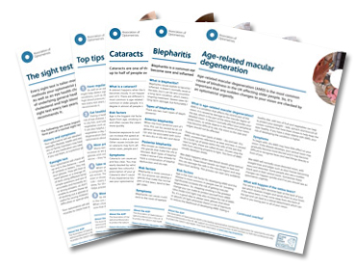
AOP PILs

Slide 18
Knowledge
Knowledge
‘Unfortunately I’ve got some bad news for you’
‘Mrs. Smith, I’m so sorry to have to tell you this’
Pause wait for them to take a breath
Use short simple clear sentences
Avoid medical jargon- assume minimal Health Knowledge

Slide 19
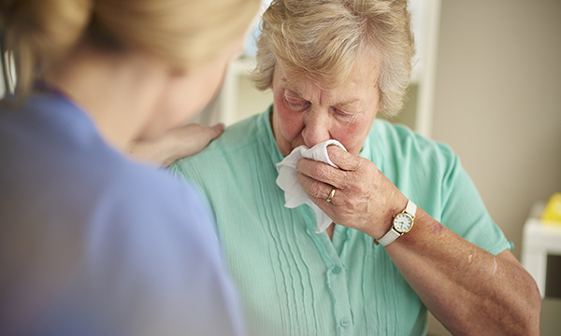
Empathy/compassion

Slide 20
Empathetic Statements
Empathy
How does that make you feel?
I can see how difficult this is to take in
That must be terrible for you!
I can totally see why you would be upset
I’m sure some of this news must come as a shock to you

Slide 21
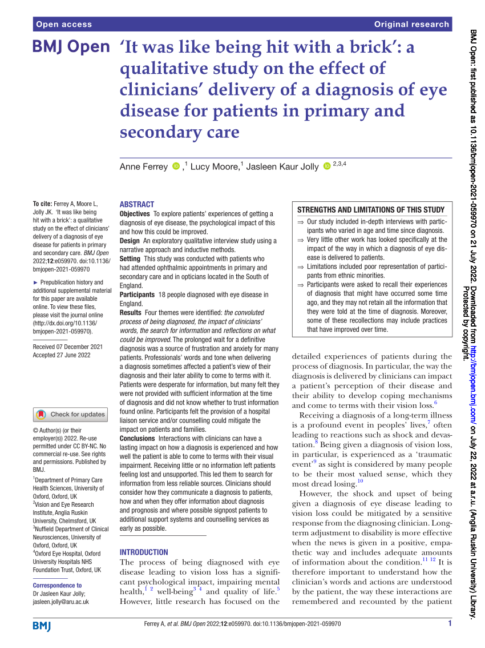
‘It was like being hit with a brick’

Slide 22
18 people diagnosed with eye disease
4 main themes
The convoluted process of being diagnosed- frustration & anxiety
The impact of the clinicians words
The search for information- untrusted sources, dodgy websites
Reflections on what could be improved- person centred approach

Slide 23
Impact of the Clinicians words
Long term adjustment to a disability is more effective when the new is given in a positive, empathetic manner.
Understand how the clinicians words & actions are understood, it impacts a patients ability to come to terms with their condition and are often recalled years later.
Patients who felt pitied had a negative view of their diagnosis compared with a more positive outlook for patients who were admired for how well they are coping
Tone of Voice- not callous, not condescending

Slide 24
Empathy
3 ways how to show Empathy
Put yourself in the patients shoes and see the world from where they are sitting
Improving your listening skills –give undivided attention, get rid of distractions
Let the person speak without interrupting them- it is a sign of Respect. ‘GP Timing’
Eye Contact- be aware of cultural sensitivities and autism spectrum may feel threatened by it

Slide 25
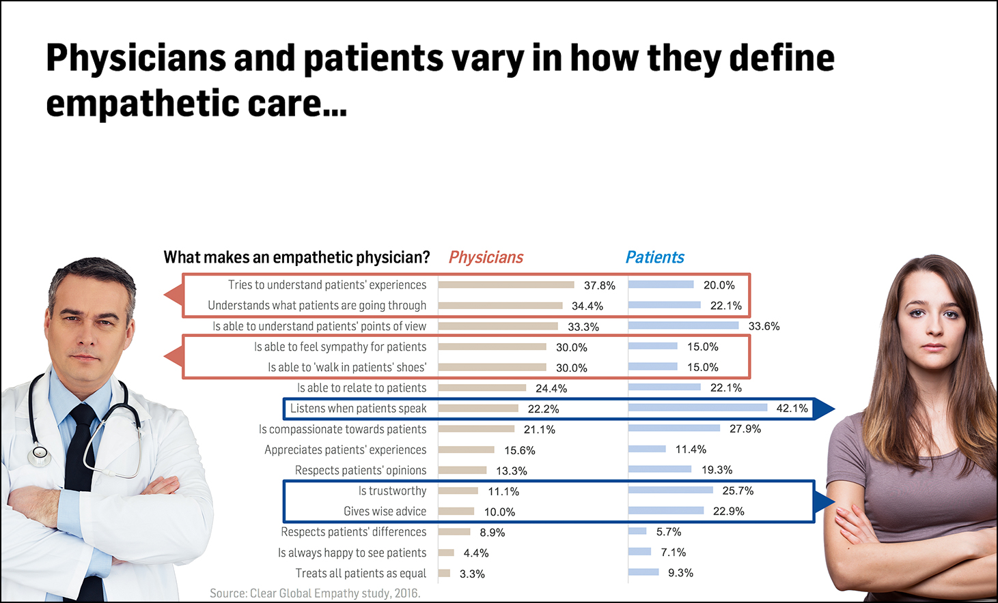
Doctor vs Patient views on Empathy

Slide 26
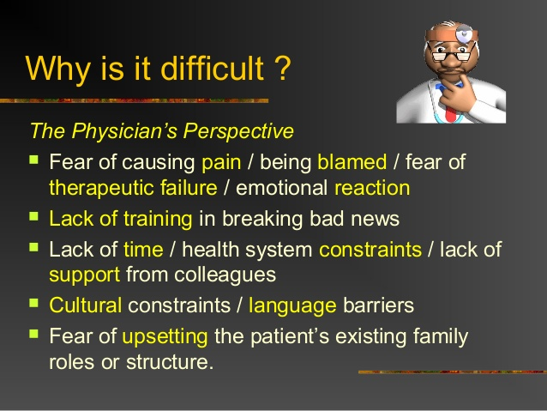
BBN is not easy

Slide 27
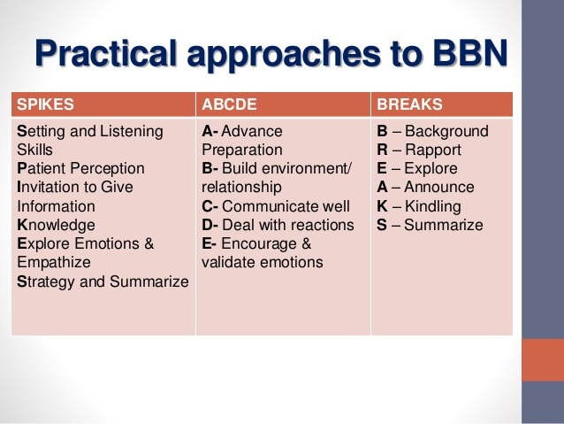
BBN Models

Slide 28
Diolch Yn Fawr Iawn

