Slide 1

Looking after the professionals
Michael Bradbury
Regional Optical Committee Engagement Officer

Slide 2
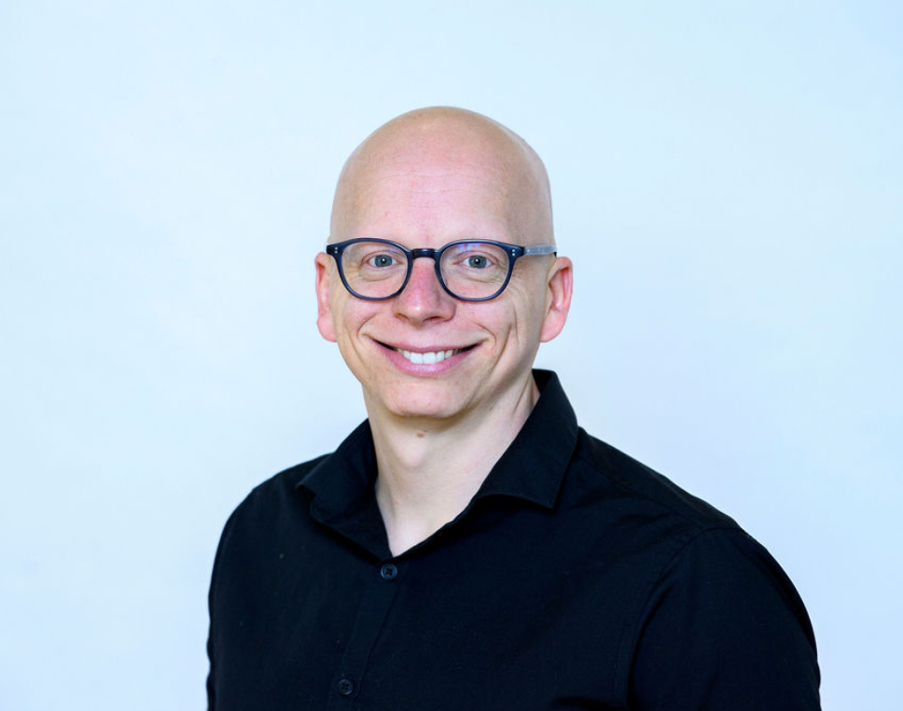
My role & background
Support ROC chair and committee representatives with meeting attendance, reports etc.
Maintain and increase local engagement with ROC
Future pipeline for ROC committee of colleagues who are invested in the progression of the profession for Wales
Support for collaborative leads involved in cluster working- development of resources, sharing of best practice, engagement of practice leads to prevent breach notices etc.
Notes:
Background: An optometrist, qualified 13 years. I have been a hospital optometrist, an independent practice owner, then more recently in national leadership role with Specsavers before joining Optometry Wales.
My national role with SS started in Summer 2023, so essentially my role became understanding WGOS changes inside and out and helping practices & practitioners get ready for the seismic change in the way optometry is delivered across the whole of Wales.
In Feb 25, I joined Optometry Wales taking on the new role of ROC Engagement Officer for each of the ROCs so I support locally but in all 3 regions (N, SW, SE). The role broadly involves (read off slide)

Slide 3
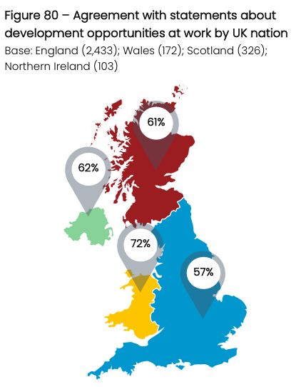
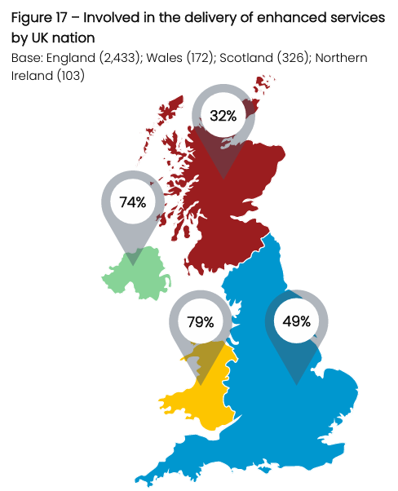
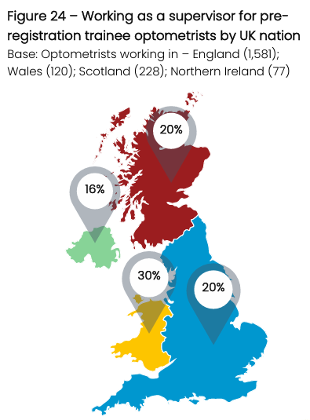
Stress in the workplace
Notes:
The General Optical Council (the regulatory body of the profession) 2025 Workforce and Perceptions Survey gained more than 3700 responses. Firstly, some of the more worrying trends
Stress with work is high- sometimes or frequently working beyond their hours (66%) and feel unable to cope with their workload (57%) as well as an increase in number of clinicians planning to leave the profession entirely (18% +4%) or reduce their hours (28%)
Overall job satisfaction 62% → 58% → 55% (2023 – 2025). But what drives satisfaction? The main reason was if the work is interesting and rewarding.
Why did people want to become optometrists in the first place? 2/3 stated that they had an interest in eye health & eye care & > half (55%) wanted to help people
So for us in Wales, are there reasons to be optimistic?
Optometrists working in Wales felt more likely to have opportunities to develop at their workplace and were more likely to hold an additional qualification & be involved in enhanced services.
They were also more likely to have supervised within the last 12 months, however the warning here is that is also more associated with feeling unable to cope with their high workload
Regarding stress in our sector: Research carried out in 2024 (lead author Neil Retallic- Head of Optometry Development in Specsavers), 37% of the 1,303 qualified optometrists scored for moderate to severe distress, 24% of respondents screened positive for depression and 28% screened positive for anxiety. 1 in 5 had sought help from a healthcare professional in the last 12/12 and 17% said they were on some form of treatment (counselling, medication)

Slide 4
Stress in the workplace
3 factors associated with worse psychological distress
Younger age
Worse physical health
No additional roles
3 factors associated with depression & anxiety
Younger age
Worse physical health
Not being IP
Notes:
Regarding stress in our sector: Research carried out in 2024 (lead author Neil Retallic- Head of Optometry Development in Specsavers), 37% of the 1,303 qualified optometrists scored for moderate to severe distress, 24% of respondents screened positive for depression and 28% screened positive for anxiety. 1 in 5 had sought help from a healthcare professional in the last 12/12 and 17% said they were on some form of treatment (counselling, medication).
For stress and for depression & anxiety, the predictors were similar (read from above). In general, the strongest predictor was physical health. If someone has poorer physical health, you’re more likely to have poorer mental health as well.
Can we utilise this information to support our clinicians in Wales? The research author identified 2 areas to focus on:
There is what the individual can do through self-care and finding a work-life balance, ensuring you’ve got the right support and are making healthier lifestyle choices. There’s also what you can do when you are in work or in other environments in your own personal life to minimise the chance of stress happening and how you would respond to it
Organisational level- What can organisations and professional bodies do to make sure that we’ve got the right working environments for people to foster good workforce relations and the right conditions?

Slide 5

What can we do to help?
Notes:
What can we do to help?
1. Self-help, individual level support
Improving awareness of NHS mental health support and relevant charities (next slide, posters)

Slide 6


What can we do to help?
Notes:
Here in Wales, there is a CALL helpline open 24/7 which can offer confidential emotional support and advice to both an individual and their family. It will help you contact support available in your local area. The Freephone number for CALL is 0800 132 737. There is also information about looking after your mental wellbeing on the CALL website: https://www.callhelpline.org.uk/
NHS 111 Press 2 is a Wales-wide service, a single point of access into all 7 Health Boards, with local mental health knowledge & access to Mental Health pathways.

Slide 7
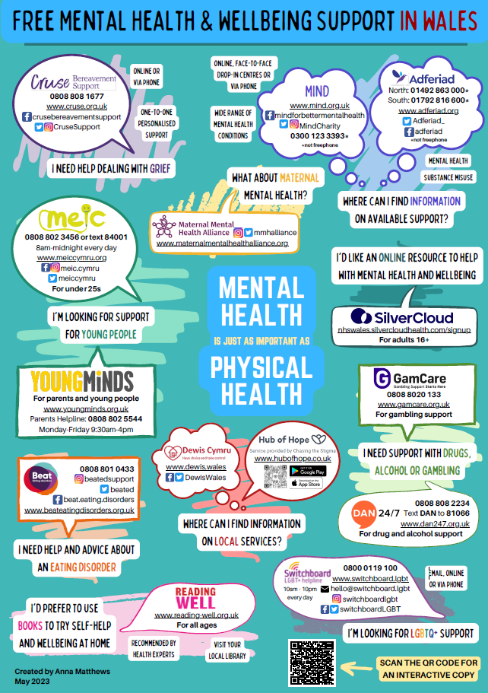

Notes:
There is a host of support services available to people, but if we can increase people’s awareness of how they can access support for themselves is really important.
Credit goes to the Community Pharmacist in CTMUHB who created posters following discussions in their cluster which were shared with all community pharmacies in Wales and they have kindly agreed for Optometry Wales to share with all optometry practices
What else are we doing? (next slide)

Slide 8
Wellbeing CPD
Wellbeing CPD for ECPs and all practice staff
CPD accredited
Serve yourself before serving others
Wellbeing CPD focuses on ECP and ends with the difference they can make with every patient
Notes:
Wellbeing workshop roadshow- I have presented a proposal to each of the ROC committees; the ROCs will be jointly delivering a Wellbeing CPD (continued professional development points) roadshow Jan 26 with the excellent, award winning Piyus Tanna and Sheena Tanna-Shah
We will also promote relevant CPD sessions that have been produced previously (DOCET Feb and March 2025)

Slide 9
What can we do to help?
Notes:
2. Organisational Level
Occupational health access for primary care optometry- this is managed at a health board level following contract reform in 2023, which is fantastic because it means an offer of occupational health support for primary care optometrists in line with other primary care professions. I have clarified with every Local Health Board in Wales, what services can optometry practice colleagues access? The answer is currently, it varies by area… in some areas primary care optometrists can access an occupational health assessment, but no direct access to mental health services.
Optometry Wales now hosts any relevant documentation for practitioners on the members’ section of its website. This is an area that could be improved to support colleagues.
OW national work- minimise variation of WGOS services, working with NHS Wales at a national level through the ECWC national governance oversight committee and its sub-groups. This supports practices, locums and cross-boundary work to help reduce stress and maximise service provision for patients. This work is vital, including the frustrations caused by various different (and not fit for purpose) pieces of paperwork, referral forms, various MS Forms etc. The work is ongoing to produce better, more efficient and effective routes of referral with reduced variation and the profession welcomes the move towards full digitalisation so that practitioners can spend more time with their patients.
Thank you to WCB, their work producing the new website the Wales Vision Forum which does exactly this- helping practitioners to deliver better care and being able to access resources more simply makes their job more rewarding and less stressful, this aids job satisfaction, workforce retention and so improves access to patient care for EVERYONE
ROC local work- engagement work, comms to help with change, ensure people understand what is being asked of them. I’m really pleased to say that attendance at recent ROC meetings is better than ever with over 100 attendees across the latest series of ROC meetings, a more engaged workforce must be a good sign of things to come!

Slide 10
Looking after the professionals
Thank you

