Slide 2


Slide 3
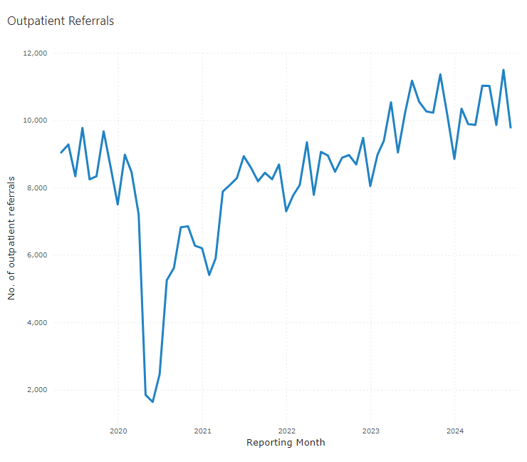
Demand for Hospital Services- New Patients
In 2019/20 referrals for ophthalmology were on average 8,619/ month or 1,945/ week.
During 23/24 this increased to 10,532/ month or 2,340/ week.
This demonstrates an increase of approximately 22% on average per month over the previous 3 years.
Between April – August 2024 the average monthly referrals are 10,634 or 2,441/ week.
Age standardised referrals per 100,000 population also demonstrates variation across Wales.

Slide 4
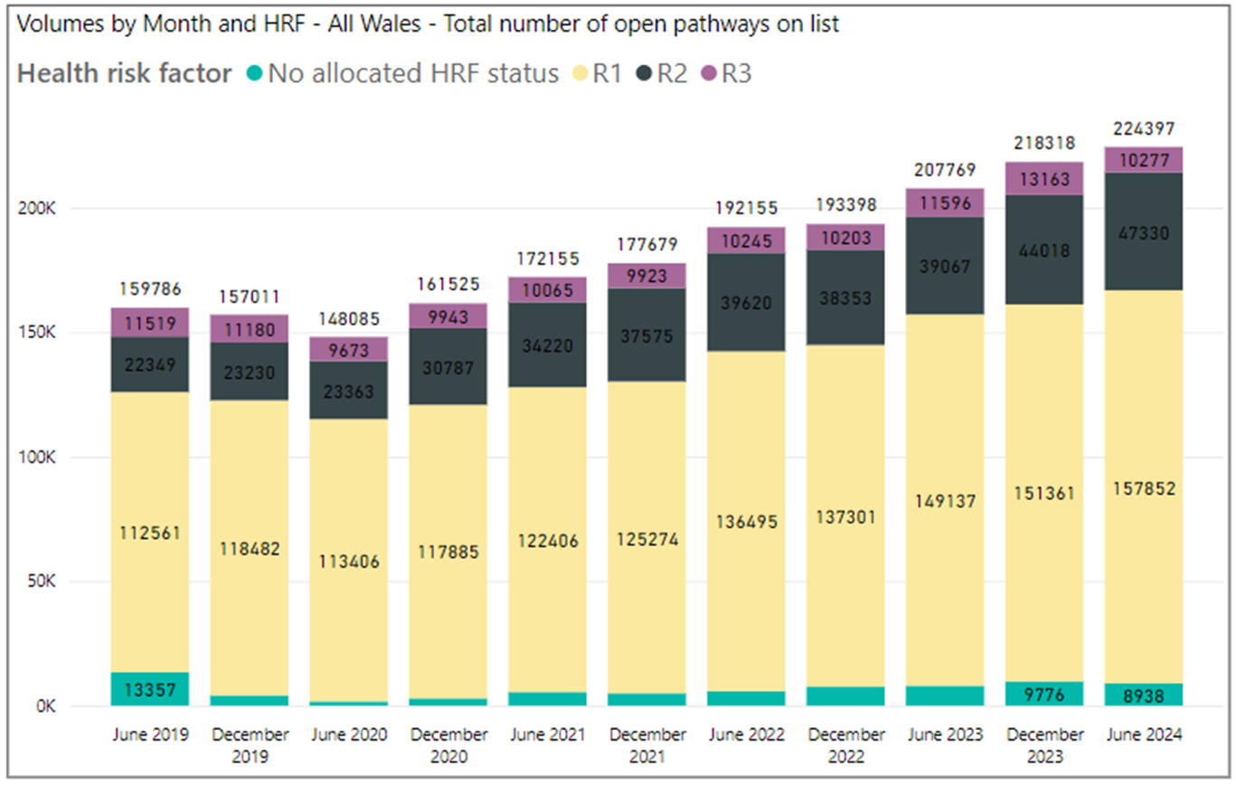
Patients Waiting
Total Number of Open Pathways Including Follow-ups

Slide 5
National Clinical Strategy for Ophthalmology
NCSOphth
At the start of the NHS executive government commissioned a clinically led blueprint for the delivery of Ophthalmology services across Wales
This followed on from the National Clinical Strategy for Orthopaedic Surgery (NCSOS) which successfully demonstrated the problems in Orthopaedics but also provided solutions
Has led to significant investment in services across Wales including new regional high volume surgical hubs.
NCSOphth will form the work of the Clinical implementation network

Slide 6
Structure of the Strategy
Evidence was collected by:
Consultation
Data requests
Epidemiological
Outcomes
Strategic themes
Next steps

Slide 7
Consultation
3 face to face regional consultant workshops
Wider stakeholder engagement
patient facing non-medical clinicians,
administrative support staff,
health board operation leads, and
primary care teams.
Health Education and Innovation Wales
Third sector partners

Slide 8
Consultation outcomes
Three main areas of concern:
  Workforce
  Estates
  Digital

Slide 9
Workforce
Wales has one of the lowest consultant ratio per head capita at 1.8 per 100,000
Significant difficulties with recruitment and retention in all medical grades
Workforce problems in many other essential areas including nursing, orthoptics and administration roles.
Barriers to recruitment are complex and require more detailed analysis

Slide 10
Estates
Every unit in Wales is in a poor state of repair and does not have enough physical capacity to meet needs
Examples include;
Aneurin Bevan UHB – Roof collapse 2023 due to faulty over flow
Cardiff and Vale UHB – Regular flooding of out patient and injection rooms due to faulty sewerage pipes
Besti Cadwallader UHB – Ivy growing through the walls of out patient departments and leaks from faulty roofing
Hwyel Dda UHB – theatre sites with limited access for wheelchair patients

Slide 11
Digital
No unit in Wales has a fully functional EPR despite significant investment for a national procurement of Open Eyes in 2019
Health board systems do not communicate with each other or internally
Primary care optometry has no access to secondary carerecords limiting potential of WGOS 4

Slide 12

Demand and Capcity
Data requests made from each HB around demand and capcity
Requests that sub specialty data provided
Requests that accurate capacity data is included

Slide 13

Findings
Data responses from HB were variable and interpreted differently
Demonstrates that we are potentially using inaccurate data for service design and delivery
Little consistency of coding and outcomes
Reporting very different across HB and sometimes between sites within single HB

Slide 14
Epidemiology
Working with Department of Mathematics, Cardiff University known prevalence and incidence data for the 3 largest demand specialties to demonstrate how the demand on services will develop over next 10
  Cataract
  Medical Retina
  Glaucoma

Slide 15
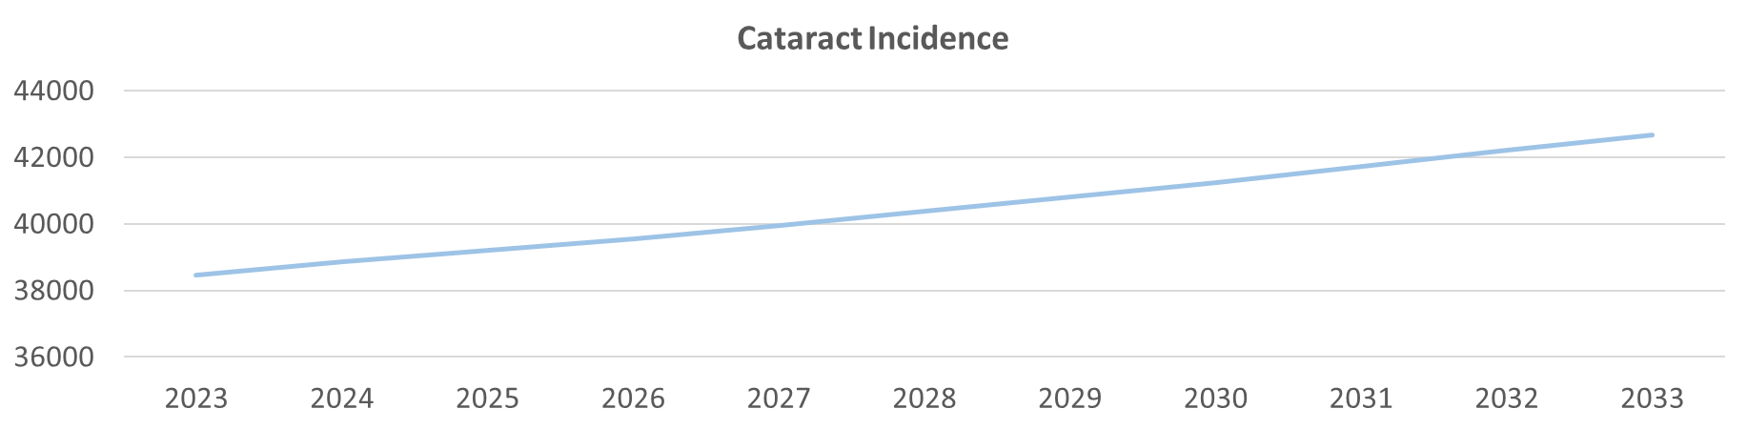
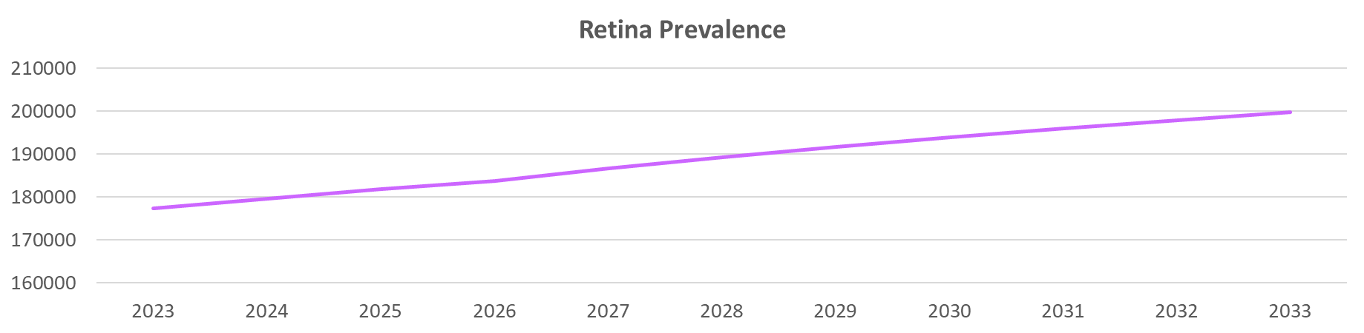
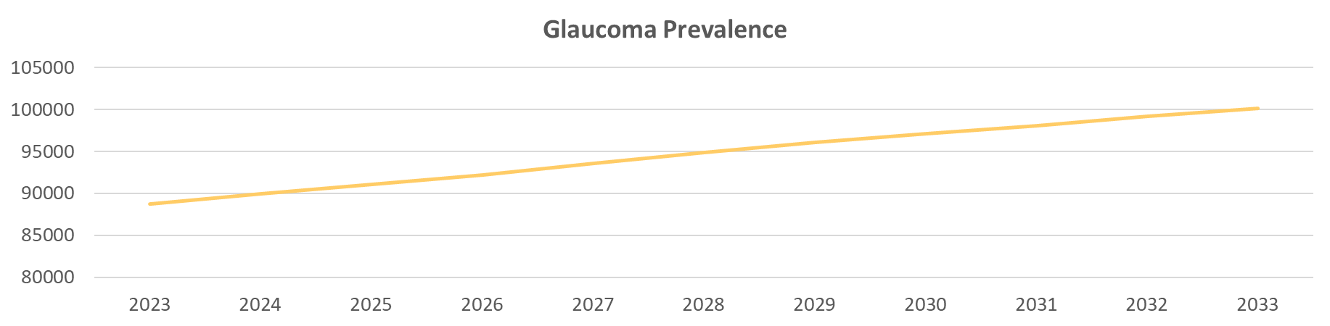
Cataract increase – 11%
Glaucoma increase – 11.7%
Retina increase – 13%

Slide 16
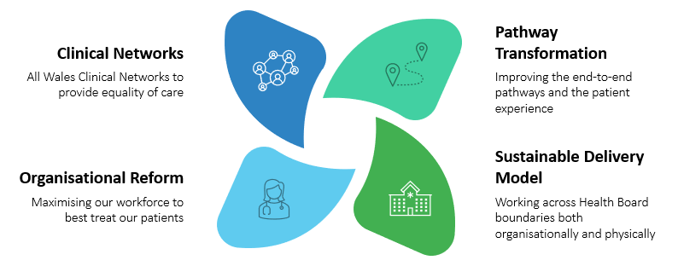
Strategic Solutions

Slide 17

Clinical Networks
Patient engagement and third sector partners
Centralise care to patient need and expectations
Work with third sector partners across Wales to ensure NCSOphth maintains the patient at the heart of transformational change
Work with PECS to ensure that patients moving into community-based care are not disadvantaged
MDT working
All Wales Clinical Networks to deliver the highest quality evidenced based care and ensure equity across the Nation
Clinical reference groups

Slide 18

Organisation reform
Organisational Principles
Health boards to align to a regional way of working
Workforce Principles
Development of cross professional workforce plan

Slide 19
Pathway transformation
Ensuring pathways across the entirety of the patient journey provide seamless integrated care delivered to nationally agreed standards
Integrated Eye Care
Work to break down barriers between primary and secondary care
Secondary care pathways
Recognised UK guidelines adapted to delivery in a Welsh healthcare system.
Standardised pathways
Implementation of clinically agreed

Slide 20
Sustainable delivery model
Training and research
Increase Ophthalmology training places in Wales
Implement Ophthalmic Local Training across Wales
Research will be integral to Eye care in Wales in primary care, secondary care and University settings
Estates
Centralise complex care in Ophthalmic specific estates and provide less complex care closer to home
Digital strategy for Eyecare
Roll out of ophthalmology specific electronic patient record and electronic referral system across primary and secondary care
Sustainable regional delivery of an integrated eye care pathway

Slide 21
Requests
Welsh Government
Requested to endorse NCSOphth and make a firm commitment towards supporting the strategic ambitions for Ophthalmic Regional Services in Wales both through a policy driven and investment approach.
Drive integration of secondary and primary care services and move to a regional targets and performance model – not Health Board based
Establish a dedicated non-clinical director for Ophthalmology within NHS Executive
To prioritise the digital eye care solution

Slide 22
Health Boards
Commit to true regional delivery model without boundary constraints
Implement recommendations from NCSOphth and the CIN
Actively engage with change and remove barriers
Prioritise Ophthalmology plans
Honour commitments made to Ophthalmology
Work with current workforce to maximise productivity and efficiency
Where possible increase and improve physical estates to acceptable standard
Aim to improve recruitment
Provide data analysis support to ophthalmology departments to help provide accurate data to support services

Slide 23
HEIW (Health Education and Innovation Wales)
Support the expansion of the Ophthalmology workforce and work with HB to deliver increased training capacity
To consider all non-medical eye care professionals within HEIW to ensure equity of access to training for all eye care professionals regardless of initial professional qualification

Slide 24
Next steps - secondary reports
Sub specailty reports
Workforce training and research
A digital strategy for Wales
Patient centred care

Slide 25

Diolch
Notes:
In short this is an extremely high level overview of the current challenges and changes that are taking place in Wales. It is an honour from me to be serving my colleagues in wales and try to drive forward what is dramatic but much need change. Its an exciting, frustrating, and demanding role but I can see how by working together we can drive real, clinically lead, patient centred change in Wales

