Slide 1
Curriculum Framework for Children and Young People with Vision Impairment (CFVI)
Presented by Sarah Hughes
Chair of WAVIE (Welsh Association of Vision Impairment Educators)

Slide 2
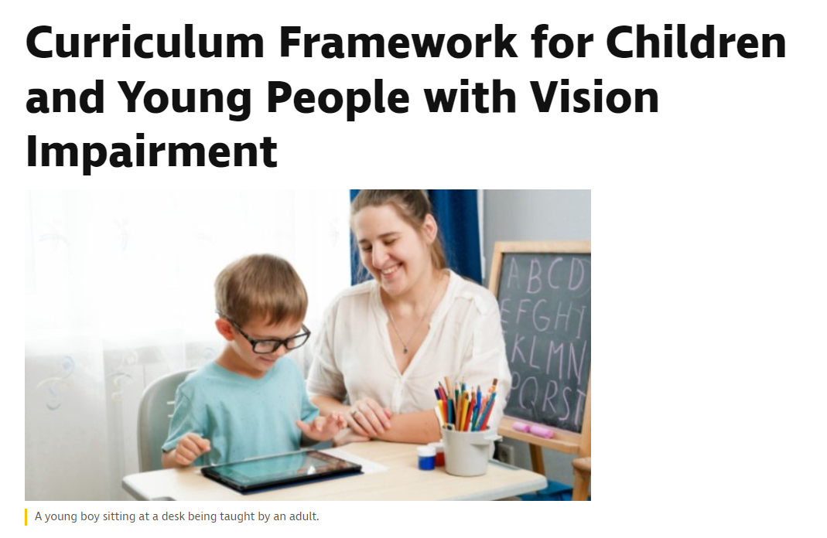
Where to find the CFVI
Google search –
RNIB CFVI
Download resources in Welsh or English, including a parents’ guide.
Curriculum Framework for Children and Young People with Vision Impairment | RNIB | RNIB

Slide 3
Three fundamental aims of the CFVI
Clarify and define the specialist skill development, essential for children and young people with vision impairment (from birth to adulthood);
Raise awareness of the need for children and young people with vision impairment to be taught skills, to access the curriculum and the wider world with as much independence as possible;
To aid discussions and understanding amongst all involved in a child/young person’s education, of how and when these skills should be taught by suitably qualified specialists.

Slide 4
The 11 areas of learning defined by the Curriculum Framework for CYP with VI (CFVI)
1. Facilitating an Inclusive World
  Recognising the role of educators (including specialist practitioners) and parents/carers as facilitators and advocates for children and young people with vision impairment in education and society.
2. Sensory Development
  Working with the children and young people to maximise use and development of the senses.
3. Communication
  Working with children and young people to develop their social communication skills.

Slide 5
The 11 areas of learning defined by the CFVI
4. Literacy
  Working with children and young people to develop literacy skills.
5. Habilitation: Orientation and Mobility
  Supporting children and young people to be able to move safely through their world as independently as possible.
6. Habilitation: Independent Living Skills
  Supporting children and young people to develop the day-to-day skills they need in order to live as independent a life as possible.

Slide 6
The 11 areas of learning defined by the CFVI
7. Accessing Information
  Teaching of methods children and young people can use to access, produce and manage information independently.
8. Technology
  Providing training and opportunity for children and young people to use technology with as much independence as possible.

Slide 7
The 11 areas of learning defined by the framework
9. Health: Social, Emotional, Mental & Physical Wellbeing
  Providing targeted teaching and support to facilitate the development of the mental, emotional, social and physical wellbeing of children and young people.
10. Social, Sports and Leisure
  Supporting children and young people to have opportunities to participate in social, sports and leisure.
11. Preparing for Adulthood
  Supporting children and young people to prepare for their lives after compulsory education and make decisions for their future.

Slide 8
Who is delivering VI support for children and young people in my local authority
WAVIE have a list of contacts for all VI services throughout Wales. If you don’t know who to speak to about support for a child with VI in your area, please contact me.
Your local ECLO (Eye Clinic Liaison Officer) should be aware of local VI Services for children and young people.

Slide 9
Want to know more about WAVIE or education for those with vision impairment in Wales?
Sarah Hughes
Sarah.hughes@Torfaen.gov.uk
Twitter @WAVIEwales

