Slide 1

A new pathway into the Third Sector
John Dixon, RNIB Cymru and Owen Williams, WCB
Wales Vision Forum

Slide 2
Sight loss organisations in Wales
– the Wales Council of the Blind membership
Joint working
Reducing duplication of effort
Sharing information and good practice
Lobbying and campaigning
Notes:
Wales Vision Forum
The purpose of the Forum is for local, regional and national organisations representing people with sight loss to come together to share, discuss and outline work programmes and priorities to enhance joint working and reduce duplication to maximise our collective reach and impact.
The Forum is a platform for sharing information, sharing good practice and expertise, consulting and identifying opportunities to support service and campaign planning.
Some examples of work include:
CVI leaflet for patients for bilateral Dry AMD in Primary Care
Children’s leaflet for CVI
Patient voice within eye care
Another more recent example is our work on WGOS 4 guidance and sector-wide website.

Slide 3
WECC 2023
Eye Care Support Pathway report launched (copies still available!)
  Understand my sight condition
  Understand my health and social care pathway
  Able to find practical and emotional support
Invited by GOS Clinical Leads to consider support service for WGOS4 service

Slide 4
WGOS4 clinical manual
Inserted wording throughout clinical manual:
  “The Optometrist will actively seek to support a patient through the provision, signposting and/or referral to sources of trusted information and support, as part of a consultation. Local guidelines will be published by Wales Council of the Blind. Written information should be provided in the patient’s preferred accessible format.”

Slide 5
WGOS4 guidance
Optometrists ask:
Would you like more information about your eye condition and how to manage it / information to help you prepare for your hospital eye appointment?
Would you like information on practical support?
Glaucoma patients: Would you support on how best to take your eye drops?
Would you like to talk to someone about how you are feeling about your eye condition?

Slide 6
WGOS4 reporting
Reporting added to core data set
Simple Yes/No reporting for optometrists:
  Did you have a supportive conversation with the patient to discuss non-clinical support during the examination?
  Did you signpost the patient to non-clinical support as a result of this conversation?

Slide 7
Wales Vision Forum
Access to people who are expert in
  understanding the impact of a sight condition,
  living with a sight condition, and
  remaining independent.
New support offer for eye drops – Glaucoma UK mix of digital and online support, and additional training for regional sight loss organisations.
Signposting to new WalesVisionForum.org.uk site

Slide 8
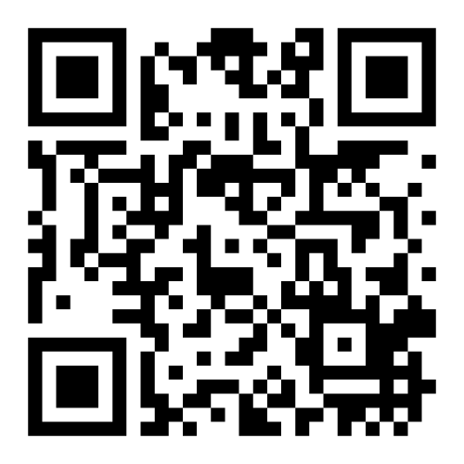
LEAFLET
EXTERNAL WEBSITE
LINK
The Eye Care Support Pathway in Wales:
The Wales Vision Forum website
POSTCODE
(OPTIONAL)
OPTICIAN
WGOS 4/5
LVSW
INITIAL APPOINTMENT
DIAGNOSIS
SUPPORT AFTER
DIAGNOSIS
LIVING WELL
PERSPECTIF
Notes:
The Sight Loss Pathway in Wales: The Wales Vision Forum website
In order to address the requirement – given in the WGOS 4 manual - to provide optometrists and patients of WGOS services with a resource for onward support in the third sector, the Wales Vision Forum agreed a structure for a website. Whilst being based on the UK Eye Care Support Pathway patient leaflet, it has been modified to take account of the additional Welsh optometric services, including the LVSW.
The proposed model for the website is a fairly simple one. Visitors may come from any source - a leaflet, newsletter, other website, a google search. Print sources like posters can make use of QR codes.
The visitor arrives at the forum site and is asked for postcode – which is optional. The postcode enables filtering by location to remove unnecessary information.
Depending on the source, the visitor is taken to a specific page in the pathway.
Perspectif, WCB’s information portal, will be running in the background to provide up-to-date information to the website. The data is maintained continually by WCB staff and volunteers.

Slide 9
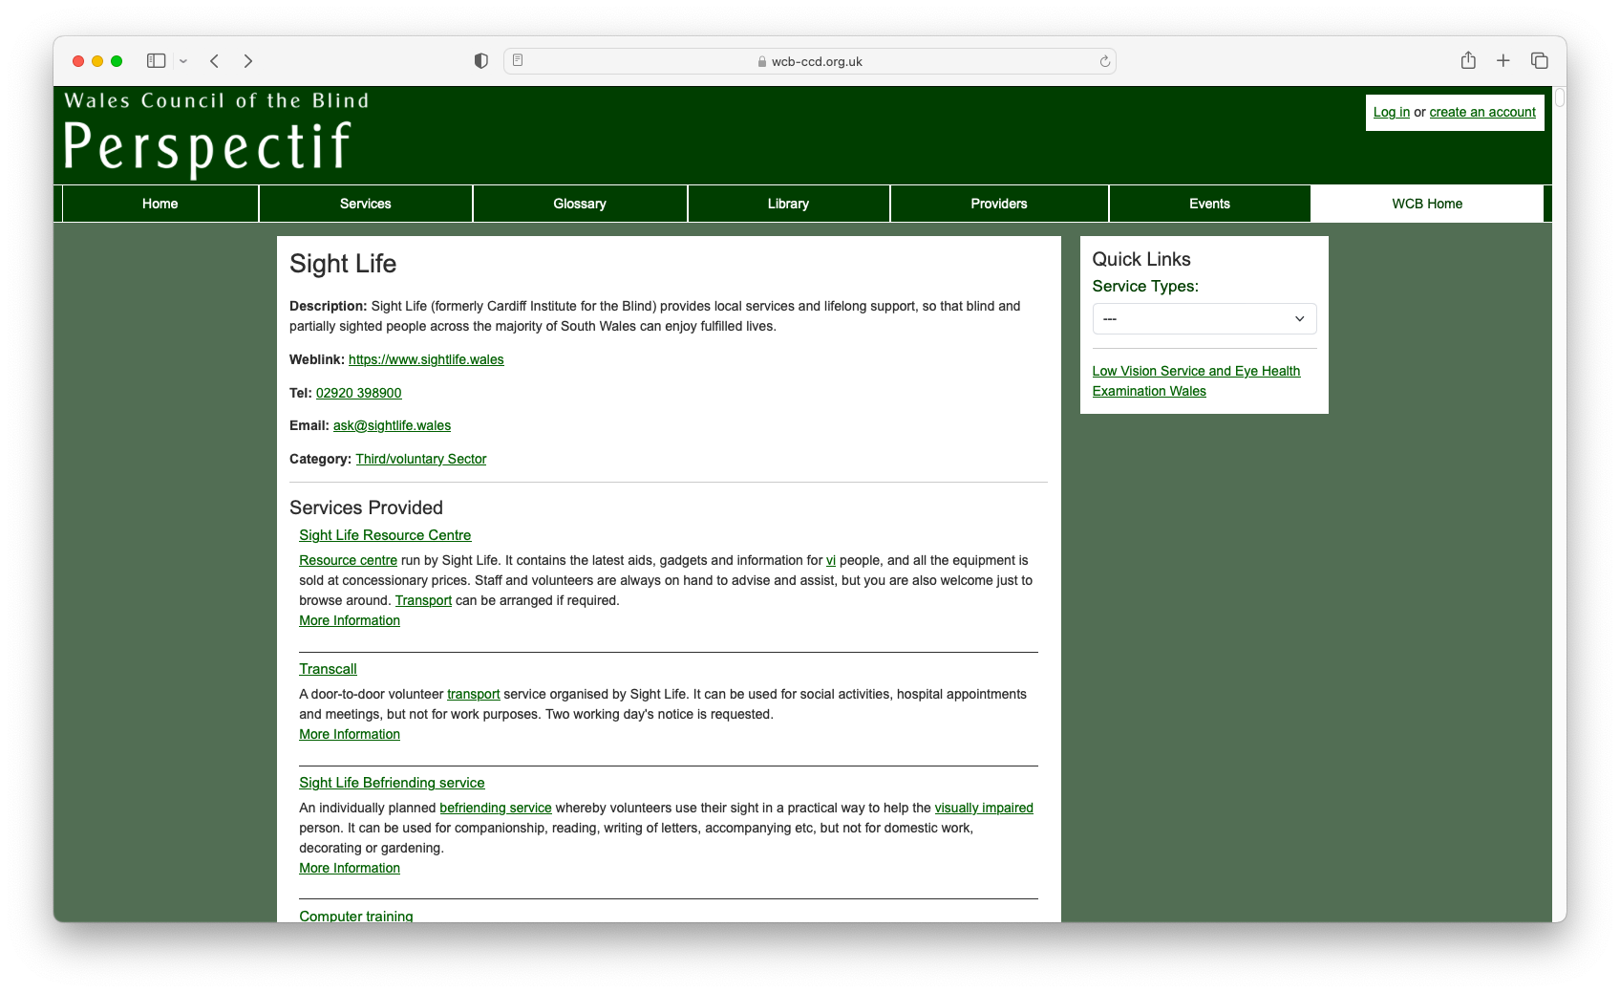
What is Perspectif Portal?
Notes:
WCB developed a database of services and support for people with sight loss in Wales and professionals who support them. From the outset, we had a clear philosophy underpinning the website: we wanted to offer the widest choice to the visitor from a single place.

Slide 10
What is Perspectif Portal?
A database structured around services and support - what not who
A focus on needs
Support from a range of organisations, not just the well-known ones
Services first, but also
  Organisations and what they offer more generally
  Events
  Library
  Glossary
Notes:
It is structured around services and support, not the organisations providing them. That’s to say, we believe that the patient would need specific forms of help or advice but are not necessarily interested in who is giving them that help. Organisations often offer a range of services which can be confusing to the patient. By focusing on what the patient needs, we can direct them more precisely to sources of help.
Services first, but also
Organisations and what they offer more generally
Events
Library
Glossary

Slide 11
Organisation
website​
Organisation helpline
Typical content per page
Static text
Links directly to external sites
Perspectif page
Links to records in Perspectif that lead to external sites
Helpline no.
Data drawn from Perspectif to populate the page
PERSPECTIF
database
Notes:
How is Perspectif being used in the WVF website?
The visitor may have scanned a QR code from a leaflet in the optometrist's, for example.
After the optional postcode entry, they are taken to the appropriate landing page.
There are three main ways to use Perspectif within the site:
Direct links to external resources. Used where they are dependable and where it would be perverse to route via Perspectif.
Links to Perspectif records – these records have the advantage of making more support visible than you want on the Pathway page. Whenever you go to a Perspectif record, more information is available: contact details, geographical coverage but also other services, events and library items. These records provide links to the organization’s pages and telephone number. A telephone number in Perspectif is an active link such that, on smartphones, the visitor can automatically dial the number. These, along with email addresses, are recorded on the server.
Data brought to the page from Perspectif such as descriptions of services, definitions of terms used in the text, latest events such as Living with Sight Loss courses. These would usually take the visitor to the source material in Perspectif so that they are availed of everything else that falls under that record. For example, a definition of Macular degeneration would link to the glossary in Perspectif under which is an automatically generated list of services and library items that use that term.
So, the landing page could be described as a shop window display, which leads you into the full range of stock within Perspectif.

Slide 12
The Eye Care Support Pathway and Perspectif
This site will represent the Wales Vision Forum and be under its control
Derived from the Eye Care Support Pathway and the questions drafted for optometrists re WGOS 4 signposting
Additional material to reflect Welsh variants
Taking a concrete, supportive approach
Uses Perspectif as a database to populate the pages with current information
An opportunity to integrate a range of routes into the pathway
Should make using Perspectif easier and better focused for a new visitor
Notes:
This site will represent the Wales Vision Forum and be under its control. A Steering Group will be established with the Forum to keep it on track.
It’s derived from the Eye Care Support Pathway and the questions drafted for optometrists regarding WGOS 4 signposting. It shall use the structure of the pathway across its pages.
There’s additional material to reflect Welsh variants including the WGOS 3, 4 and 5 information.
It takes a concrete, supportive approach by directing to resources within Perspectif and beyond.
Uses Perspectif as a database to populate the pages with current information. This is important because many external sites are updated structurally from time to time. We have link checker to keep on top of changes in external sites. Perspectif structures the essential information uniformly - external sites have varied structures. So, Perspectif makes it simpler for the patient to find information.
The model offered an opportunity to integrate a range of routes into the pathway INCLUDING a generic Third Sector support page – representing the local, regional and national sight loss charities. It is likely that recommendations emerging from the Loneliness and Isolation research and Children and Young People’s access to LVSW research will make use of this model.
This is a curatorial approach which should make using Perspectif more focused while allowing visitors to dig deeper should they wish. Perspectif will always be accessible from the WVF pages. This means we don’t have to compromise the integrity of the pure Perspectif portal.
It also allows Wales Vision Forum to influence how the sector’s resources are presented to visitors to the site.

Slide 13
www.walesvisionforum.org.uk
Notes:
LAUNCH IN THE NEW YEAR

