Slide 1
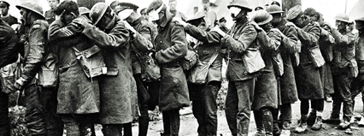
Who we are
Blind Veterans UK
Notes:
Consider using interactive history game.
The image depicts soldiers leading one another away from the battlefield with their hand on the shoulder of the man in front.
In 2018 we unveiled a statue of the same image, realised by artist and sculptress Johanna Domke-Guyot, entitled Victory Over Blindness. It stands proudly outside Manchester Piccadilly station as the only permanent memorial to the injured of that conflict.

Slide 2
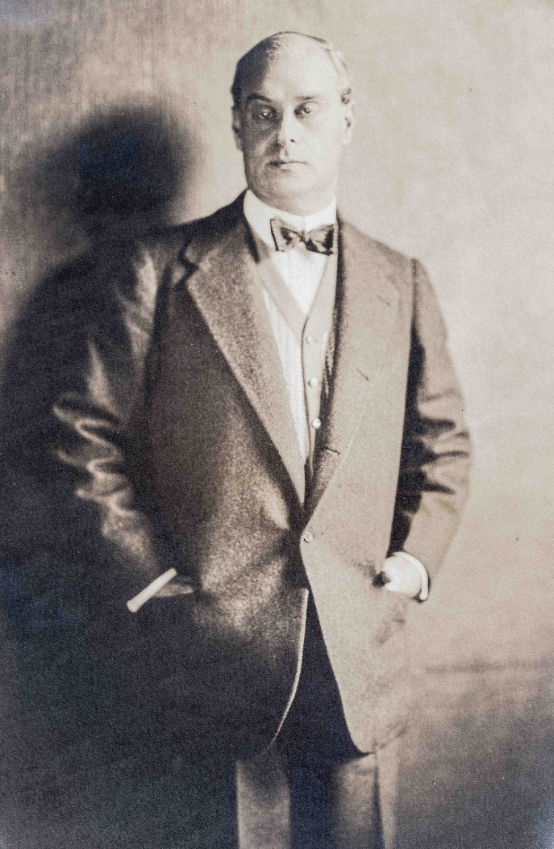
Origins of Blind Veterans UK
Joined the Council of the NIB in 1913
In 1923 we officially adopt the name ‘St Dunstan’s’
2016 Rebranded to Blind Veterans
Pictured: Sir Arthur Pearson
Notes:
As a result of his own experiences with sight loss, Sir Arthur joined the Council of the National Institute for the Blind (what was the RNIB) in 1913; first he served on the council as a Treasurer before sitting as the President
In 1914 he helped to run the Prince of Wales’ National Relief Fund, which had been created to alleviate distress caused by the war
He visited hospitals to meet men blinded in the war. He recognised that a blind man, above all, needed an occupation and he imagined a hostel where blindness would be viewed as a challenge to overcome, not an affliction to be borne.
With access to London’s elite society, he was able to secure donations from many rich benefactors and The Blinded Soldiers & Sailors Care Committee was formed on 6 February 1915. It moved to St Dunstan’s Lodge, Regent’s Park on 26 March.
The charity allowed wounded ex-servicemen to convalesce and receive rehabilitation support and occupational training. sport and social activities were also encouraged.
In 1923 we officially adopt the name ‘St Dunstan’s’, a name the charity had been generally known as since the earlier days in Regent’s park.
Interesting Fact: St Dunstan is not the patron saint of the blind, as is commonly assumed. It was the name of the clock that hung at the lodge in regent’s park. St Odile & St Lucy are the patron saints of the blind

Slide 3
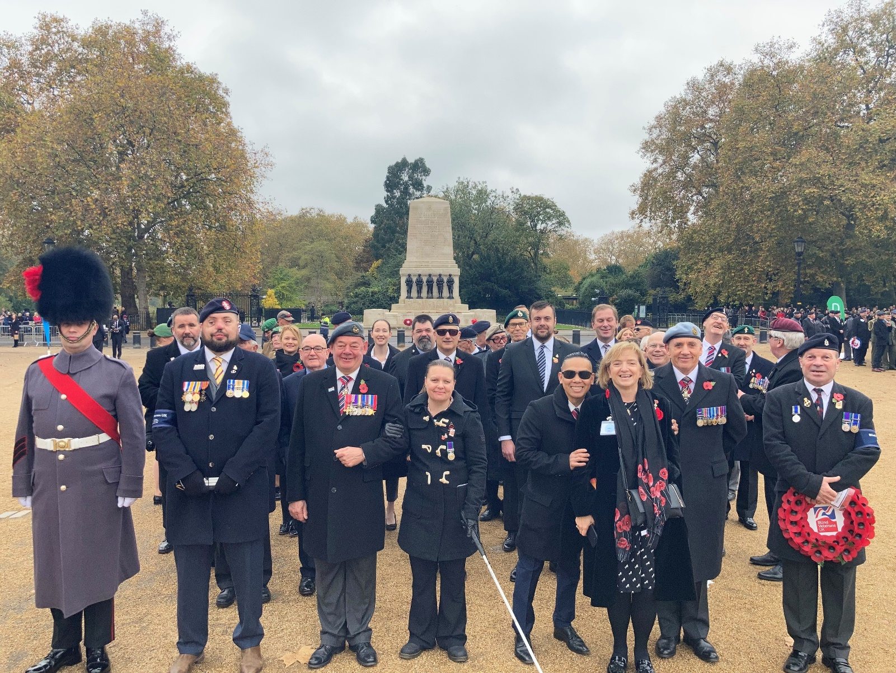
Our history
Blind Veterans UK is the national charity for ex-Service men and women with severe sight loss. Also support Blue Light services who have lost sight in service.

Slide 4
Our eligibility criteria
Sight loss criteria
You must have sight loss of equal to or worse than 6/60 in one eye and 6/24 in the other. This usually means that you are unable to read the top line of an eye chart with one eye and the third line of an eye chart with the other.
If you have a certificate of vision impairment (CVI) stating that you are severely sight impaired (blind), and you meet our service criteria, you will automatically qualify for support.
You may also qualify for support if you have peripheral vision loss caused by eye conditions such as glaucoma, retinitis pigmentosa or optic neuritis.
Applicants who have been assessed by Blind Veterans UK Ophthalmic Consultant to have a degenerative sight loss condition that is likely to result in the applicant meeting the admission criteria, listed above, within the next 12 months.

Slide 5
Service criteria
You must have been part of the military or emergency services to be eligible, and meet the conditions outlined below:
Military/National Service
You can apply for support if you served in:
the UK Armed Forces, including National Service or the Reserves
Polish or Indian forces under British command
the Merchant Navy, deployed within a combat zone in direct support of UK military forces
Emergency services
You can apply for training and technical support if you have a vision impairment and served in the emergency services – police, fire brigade or ambulance – but only if you lost your sight while on duty.

Slide 6
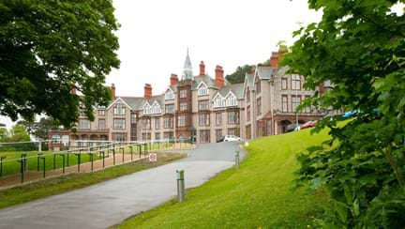
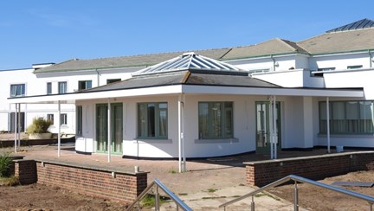
Centres of wellbeing
Pictured: A colour image of the centre in Rustington
pictured: A colour image of the centre in Llandudno centre
Notes:
As the charity grew and welcomed more veterans through its doors, a site on the hills at Ovingdean was purchased.
A new, purpose-built building for the blind, was designed with input from those who would be using it. The centre would have convalescence, rehabilitation and training, all under one roof with breath taking views of the south coast.
Our Brighton Centre, the first of its kind, was completed in 1938 and remains today; offering permanent residences to some of our veterans, respite care to those who require it, and full access to our rehabilitation and training services.
We’ve added a little extra since it was built in 1938, with a swimming pool, gym and arts and crafts workshops, which you can see in the colour image on the right-hand side.
Unfortunately, with the outbreak of World War II, we were evacuated to Church Stretton in 1940 and did not return to Brighton until 1946. During this time the centre was used as an eye hospital.

Slide 7
Centre facilities
Each centre has the following;
outdoor terraces,
a fully equipped gym,
a sports and activity hall,
an arts and crafts workshop,
communal lounges and a bar.
Both centres offer a huge range of social, creative, leisure and sporting activities.
Staff assist our blind veterans with their fitness, mobility and wellbeing.

Slide 8
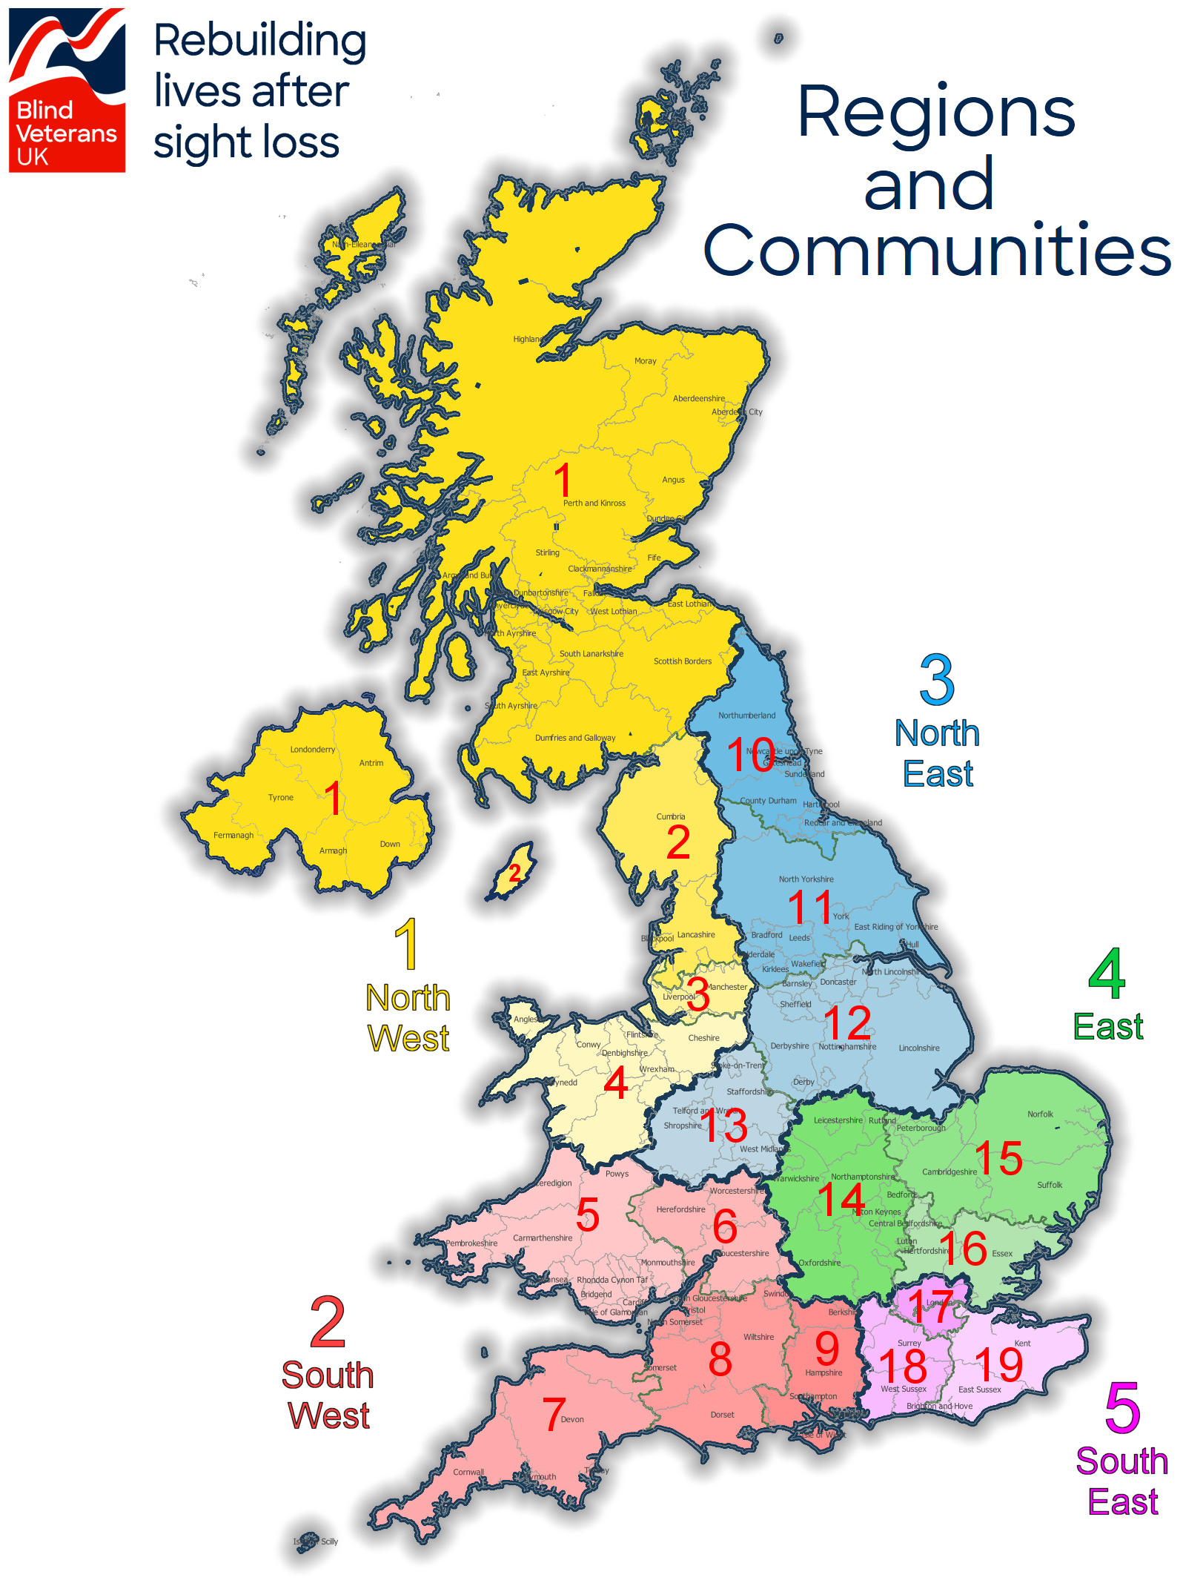
Community Teams
Community teams provide veterans with rehabilitation, training, practical advice and support.
Notes:
VC to add Regional detail & map

Slide 9
Community
We offer a bespoke service to every one of our beneficiaries, providing rehabilitation, training, practical advice and emotional support for life.
Whether it’s day-to-day living, getting out and about or staying in touch with loved ones, our staff help our beneficiaries adjust to life with a vision impairment and relearn vital life skills.
We can support remotely, via phone and video calls, at home, in the local community and within our two centres of wellbeing.

Slide 10
Community Teams
Staff structure
Senior Development manager
Community Support Workers (Case Worker) – Carry out holistic assessment, agreed action plan with referrals
Rehabilitation Officer for Visual Impairment (ROVI) – ILS, magnification, kitchen skills, mobility, tech support
Volunteer Co-Ordinator – recruit, train, retain, match. Work in partnership with third

Slide 11
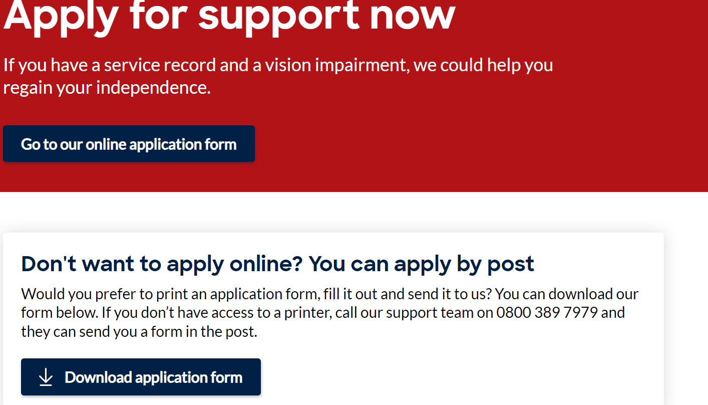
Apply for support
https://www.blindveterans.org.uk/help-info/apply-for-support/apply-for-support-application-form/
Call support team on 0800 389 7979

